Slide 1
DEFINE PHASE

Slide 2
Scenario
Textile Corporation is Pune, India based garment manufacturing company started in 2000 By Mr. Shreeram Deshmukh. Over last 15-17 years company was well handled by Mr. Shreeram, his intelligent Manager Mr. Ramesh Joshi. However, over last 3-4 years Textile corporation started seeing losses in the business.
They started receiving backorders and client complaints frequently. Mr. Ajay Rane who owns renowned garment company, was Mr. Deshmukh important client. One fine day Mr. Rane called up to Mr. Ramesh and told, “Almost 20 out 150 Sweatshirts they ordered are missing collar buttons, 4-5 Sweatshirts are damaged pieces. Not only this, I was supposed to export few Sweatshirts to US based client yesterday but I couldn't because of these issues. I lost export opportunity and paid heavy penalty to the clients for the same. Mr. Ramesh, this was my last assignment to your company, I will not purchase any further product from your company." This is seventh client Textile corporation lost over last six months.
Mr. Ramesh told about this incidence to Mr. Deshmukh and also said, "We already have quality target of 95% to be achieved. I am not understanding why such problems are frequently occurring". Mr. Ramesh and Mr. Shreeram are in trouble and need some help to regain there market share.

Slide 3

Identification of VOC and I-E Customers
Parameters | Identified Area
Voice of Customer | “Almost 20 out 150 Sweatshirts they ordered are missing collar buttons, 4-5 Sweatshirts are damaged pieces. Not only this, I supposed to export few Sweatshirts to US based client yesterday but I couldn't because of these issues. I lost export opportunity and paid heavy penalty to the clients for the same. Mr. Ramesh, this was my last assignment to your company, I will not purchase any further product from your company."
External Customer | Mr. Ajay Rane
Internal Customer | Mr. Ramesh Joshi & Mr. Deshmukh
Critical to Quality | The quality performance must achieve the target of 95%
Proprietary and Highly Confidential. 2020 Pursullence Global Business Solutions. All Rights Reserved
Notes:
Business Case Premise: Textile Corporation is Pune, India based garment manufacturing company started in 2000 By Mr. Shreeram Deshmukh. Over last 15-17 years company was well handled by Mr. Shreeram, his intelligent Manager Mr. Ramesh Joshi. However, over last 3-4 years Textile corporation started seeing losses in the business.
They started receiving backorders and client complaints frequently. Mr. Ajay Rane who owns renowned garment company, was Mr. Deshmukh important client. One fine day Mr. Rane called up to Mr. Ramesh and told, “Almost 20 out 150 Sweatshirts they ordered are missing collar buttons, 4-5 Sweatshirts are damaged pieces. Not only this, I was supposed to export few Sweatshirts to US based client yesterday but I couldn't because of these issues. I lost export opportunity and paid heavy penalty to the clients for the same. Mr. Ramesh, this was my last assignment to your company, I will not purchase any further product from your company." This is seventh client Textile corporation lost over last six months.
Mr. Ramesh told about this incidence to Mr. Deshmukh and also said, "We already have quality target of 95% to be achieved. I am not understanding why such problems are frequently occurring". Mr. Ramesh and Mr. Shreeram are in trouble and need some help to regain there market share.

Slide 4

DATA COLLECTION PLAN
Click here
Notes:
Open the excel file given in this slide and understand the data.

Slide 5
PROJECT CHARTER

Slide 6
Business Case
Project Scope
In-scope: This project is applicable to service of process 1 of account 1 of Textile Corporation Pune Branch.
Out Scope: This process is inapplicable to any other branches of corresponding textile corporation and process.
Textile Corporation is Pune, India based garment manufacturing company started in 2000 by Mr. Shreeram Deshmukh. Over last 15-17 years company was well handled by Mr. Shreeram, his intelligent Manager Mr. Ramesh Joshi.
However, over last 3-4 years Textile Corporation corporation started seeing losses in the business. They started receiving backorders and client complaints frequently. Mr. Ajay Rane who owns renowned garment company, was Mr. Deshmukh important client for. Textile Corporation corporation lost seven clients over last six months. They are in trouble.
QNS
In money
Client retention rate will increase with increasing quality percentage
Team Members
Role | Name | Org.
Black Belt/ Manager | Mr. Ramesh Joshi | Textile Corporation
MBB/mentor/Sr. Manager | Mr. Joseph Arthur | Textile Corporation
GB | Mr. Ajay Raman | Textile Corporation
Core Team | Ms. Delnaz Patro, Mr. Shrinivas Gupta | Textile Corporation
Process Owner/ Champion | Mr. Harsh Jindal | Textile Corporation
SME | Ms. Heena Parmar | Textile Corporation
Finance | Ms. Neha Sajdeh | Textile Corporation
Problem Statement
Out of 92 Quality scores of historical data collection, Quality score for 84 readings is lower than target Quality score of 95%. It means that process has not met the Quality target for 91.3% of the readings, which is severe !
Project Timeline
Phase | Start Date | End Date
Define | 15th February 2020 | 27th February 2020
Measure | 1st March 2020 | 30th March 2020
Analyze | 1st April 2020 | 10th April 2020
Improve | 11th April 2020 | 15th May 2020
Control | 16th May 2020 | 30th June 2020
Goal Statement
To improve customer care service by bringing Quality Score as per the Quality target by June 2020
Proprietary and Highly Confidential. 2020 Pursullence Global Business Solutions. All Rights Reserved
Notes:
Use the following statement as business case:
Hints for Problem Statement:
Go through historical data
Find the average score in excel
Client has informed that there has to be min 95% quality met for each day delivered.
Please check percent quality each day and it should not be lower than 95%.
Hints for Goal Statement:
Please prepare your ‘time binding’ statement based on improving average quality percentage per day from current average to client specified limit..
Refer our previous project

Slide 7
SIPOC:
Fill in the gap with appropriate answer and compete the SIPOC
SUPPLIER
INPUT
PROCESS
OUTPUT
CUSTOMER
Order receiving
Material sourcing
Fabric
Manpower
Machines
Material
PP meeting
Cutting , Sewing , Printing of the garments
Checking the garments
Washing and then finishing of garments
Rechecking of the garments
Packing
Shipping
Ordered garments
Customer seeking the service.
Proprietary and Highly Confidential. 2020 Pursullence Global Business Solutions. All Rights Reserved
Notes:
Please refer process map given in next step and draw a high level process step. Also refer our training manual and other project as a reference. Insert the text box for each column to insert the answer.
Hint for fill in the blanks:
Understand the full form of SIPOC and fill in the correct word in blue box replacing the dash.

Slide 8



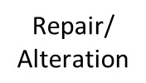
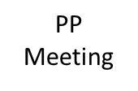
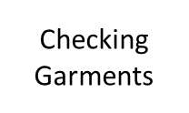

Process Map:
Quality - Help Desk Process Map
Click here
Notes:
Please refer the attached excel files for reference and clear view of process map
Observe the process map given and try to understand the flow of work.

Slide 9
COMMUNICATION PLAN (RACI MATRIX)
Sr. No | RACI | RESPONSIBLE PERSON | NAME OF PERSON
1 | Responsible | Green Belt | Mr. Ajay Raman
2 | Approve | Manager | Mr. Ramesh Joshi
3 | Consult | Sr. Manager | Mr. Joseph Arthur
4 | Inform | Process Owner/MBB | Mr. Joseph Arthur, Mr. Harsh Jindal
Review | RESPONSIBLE PERSON | NAME OF PERSON
Weekly | Responsible, Approval | Mr. Ajay Raman, Mr. Ramesh Joshi
Fortnightly | Responsible, Approval & Consult | Mr. Ajay Raman, Mr. Ramesh Joshi, Mr. Joseph Arthur
Monthly/Tollgate | Responsible, Approval, Consult & Inform | Mr. Ajay Raman, Mr. Ramesh Joshi, Mr. Joseph Arthur, Mr. Harsh Jindal
Notes:
Please refer the previous project for communication plan construction and team member from project charter of this project to construct the matrix.
Hint for fill in the blanks for first table:
Choose the correct answer from the options given below and fill in blanks in column RACI.
Sr.No 1
Report
Responsible
Receive
Regenerate
Sr.No 2
Accessible
Answerable
Accountable
Approve
Sr.No 3
Communicate
Convey
Confirm
Consult
Sr.No 4
Inform
Indicate
Improve
Innovate

Slide 10
MEASURE PHASE

Slide 11
Operational Definition
% QUALITY SCORE PER DAY
= 1- ( No. of defectives shirts / Total no. of shirts)
Performance Standards
Unit Of Measure (UOM)
Every single working day shirts manufactured.
% Quality score of shirts manufactured per day
Opportunity
Data (Y) - Continuous
Every single working day shirts manufactured
Data Source
Excel Database / Software Tool
Specification Limits & Target Value
USL – NA Target- 93 %
LSL – 91 %
Defective Definition:
Every single day when % Quality score of shirts
manufactured is below 91 %.
Proprietary and Highly Confidential. 2020 Pursullence Global Business Solutions. All Rights Reserved
Notes:
NOTE:- Performance Standards are already prepared and provided for your reference.

Slide 12
MEASUREMENT SYSTEM ANALYSIS
As Data Is Collected From System I.E. Data Is Generated From Helpdesk Ticketing Tool, So There Is No Need To Perform MSA
Proprietary and Highly Confidential. 2020 Pursullence Global Business Solutions. All Rights Reserved
Notes:
NOTE:- In this case there is no need to perform MSA as data is system driven.

Slide 13
List of Potential Causes
SR NO | CAUSES
1 | TOTAL NO. OF SHIRTS STICHED
2 | NO. OF DEFECTIVE SHIRTS
3 | FAULTY ZIPPERS
4 | IRREGULAR HEMMING
5 | WRONG GRADATION OF SIZES
6 | MISS OUT OF STITCHES IN BETWEEN
7 | WRONG STITCHING TECHNIQUES USED
SR NO | CAUSES
8 | WRONG SIZE PACKAGING
9 | WRONG COLOUR COMBINATION
10 | IMPROPER LABEL DIMENSIONS
11 | IMPROPER BUTTON HOLES
12 | LACK OF TRAINING
13 | SHORTAGE OF TECHNICAL SKILLS
14 | SEWING NEEDLE BREAKS
15 | WRONG QUALITY CHECK
Proprietary and Highly Confidential. 2020 Pursullence Global Business Solutions. All Rights Reserved
Notes:
NOTE :- Given List of Potential Causes are obtained from Brainstorming sessions conducted during measure phase along with SME’s, Process Manager provided for your reference.

Slide 14
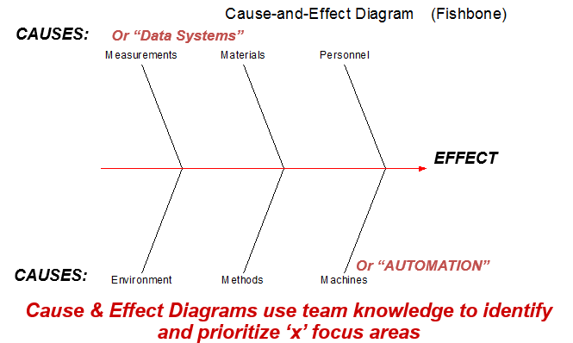
Ishikawa / Fishbone/ Cause & Effect Diagram
Total no. of Shirts stitched
Faulty Zippers
Miss out of stitches
in between
Improper Label Dimensions
No. of defective shirts
Sewing needle breaks
Irregular Hemming
Wrong Gradation of Sizes
Wrong Quality Check
Wrong Size Packaging
% Quality score of shirts manufactured
per day
day
Lack of Training
Improper Button Holes
)
Shortage of Technical Skills
Wrong stitching
techniques used
Wrong Colour
Combination
Proprietary and Highly Confidential. 2020 Pursullence Global Business Solutions. All Rights Reserved
Notes:
HINT:-
Refer to slide list of potential causes.
From the available list of potential causes, segregate those causes into the categories of Fishbone diagram.
Categorize those causes into current slide of Fishbone diagram.
Note :- For e.g.- IMPROPER LABEL DIMENSIONS is into personal category . Similarly do the remaining causes segregation.

Slide 15
C-I MATRIX
SR NO | CAUSES | TYPE
 |  | CONTROLLABLE/ NON CONTROLLABLE | IMPACTABLE/NON-IMPACTABLE | MEASUREABLE/NON-MEASUREABLE
1 | FAULTY ZIPPERS | CONTROLLABLE | IMPACTABLE | MEASUREABLE
2 | LOOSE BUTTONS | CONTROLLABLE | IMPACTABLE | MEASUREABLE
3 | IRREGULAR HEMMING | CONTROLLABLE | IMPACTABLE | MEASUREABLE
4 | IMPROPER BUTTON HOLES | CONTROLLABLE | IMPACTABLE | MEASUREABLE
5 | WRONG GRADATION OF SIZES | CONTROLLABLE | IMPACTABLE | MEASUREABLE
6 | MISS OUT OF STITCHES IN BETWEEN | CONTROLLABLE | IMPACTABLE | MEASUREABLE
7 | WRONG STITCHING TECHNIQUES USED | CONTROLLABLE | IMPACTABLE | MEASUREABLE
8 | WRONG SIZE PACKAGING | CONTROLLABLE | IMPACTABLE | MEASUREABLE
9 | WRONG COLOUR COMBINATION | CONTROLLABLE | IMPACTABLE | MEASUREABLE
10 | IMPROPER LABEL DIMENSIONS | CONTROLLABLE | IMPACTABLE | MEASUREABLE
Proprietary and Highly Confidential. 2020 Pursullence Global Business Solutions. All Rights Reserved
Notes:
NOTE:- C- I matrix is already prepared and provided for your reference.

Slide 16
C-I MATRIX
SR NO | CAUSES | TYPE
 |  | CONTROLLABLE/ NON CONTROLLABLE | IMPACTABLE/NON-IMPACTABLE | MEASUREABLE/NON-MEASUREABLE
11 | IMPROPER BUTTON HOLES | NON-CONTROLLABLE | NON-IMPACTABLE | NON-MEASUREABLE
12 | SHORTAGE OF TECHNICAL SKILLS | CONTROLLABLE | IMPACTABLE | NON-MEASUREABLE
13 | SEWING NEEDLE BREAKS | NON-CONTROLLABLE | IMPACTABLE | MEASUREABLE
14 | WRONG QUALITY CHECK | NON-CONTROLLABLE | NON-IMPACTABLE | NON-MEASUREABLE
15 | LACK OF TRAINING | NON-CONTROLLABLE | NON-IMPACTABLE | NON-MEASUREABLE
Proprietary and Highly Confidential. 2020 Pursullence Global Business Solutions. All Rights Reserved
Notes:
NOTE:- C- I matrix is already prepared and provided for your reference.

Slide 17
Data Collection Plan
CONTROLLABLE / NON CONTROLLABLE |  |  | OPERATIONAL DEFINATION | SAMPLING PLAN
What To Measure | Y Or X | Data Type | Operational Definition | What | Where | When | How Many
% Quality of shirts manufactured per day (Y) | Y | Continuous | % QUALITY PER DAY = 1- ( No. of defectives shirts / Total no. of shirts) | No of shirts manufactured per day | Database /Excel database | 02/03/2020 to 27/03/2020 | Min 30
FAULTY ZIPPERS | X1 | Discrete | No of incidences | No of shirts manufactured per day | Database /Excel database | 02/03/2020 to 27/03/2020 | Min 30
LOOSE BUTTONS | X2 | Discrete | No of incidences | No of shirts manufactured per day | Database /Excel database | 02/03/2020 to 27/03/2020 | Min 30
IRREGULAR HEMMING | X3 | Discrete | No of incidences | No of shirts manufactured per day | Database /Excel database | 02/03/2020 to 27/03/2020 | Min 30
IMPROPER BUTTON HOLES | X4 | Discrete | No of incidences | No of shirts manufactured per day | Database /Excel database | 02/03/2020 to 27/03/2020 | Min 30
WRONG GRADATION OF SIZES | X5 | Discrete | No of incidences | No of shirts manufactured per day | Database /Excel database | 02/03/2020 to 27/03/2020 | Min 30
MISS OUT OFSTITCHES IN BETWEEN | X6 | Discrete | No of incidences | No of shirts manufactured per day | Database /Excel database | 02/03/2020 to 27/03/2020 | Min 30
Proprietary and Highly Confidential. 2020 Pursullence Global Business Solutions. All Rights Reserved
Notes:
NOTE:- Data Collection Plan is already prepared and provided for your reference for both Y & X’s.

Slide 18
Data Collection Plan
CONTROLLABLE / NON CONTROLLABLE |  |  | OPERATIONAL DEFINATION | SAMPLING PLAN
What To Measure | Y Or X | Data Type | Operational Definition | What | Where | When | How Many
WRONG STITCHING TECHNIQUES USED | X7 | Discrete | No of incidences | No of shirts manufactured per day | Database /Excel database | 02/03/2020 to 27/03/2020 | Minimum 20 samples
WRONG SIZE PACKAGING | X8 | Discrete | No of incidences | No of shirts manufactured per day | Database /Excel database | 02/03/2020 to 27/03/2020 | Minimum 20 samples
WRONG COLOUR COMBINATION | X9 | Discrete | No of incidences | No of shirts manufactured per day | Database /Excel database | 02/03/2020 to 27/03/2020 | Minimum 20 samples
IMPROPER LABEL DIMENSIONS | X10 | Discrete | No of incidences | No of shirts manufactured per day | Database /Excel database | 02/03/2020 to 27/03/2020 | Minimum 20 samples
Proprietary and Highly Confidential. 2020 Pursullence Global Business Solutions. All Rights Reserved
Notes:
NOTE:- Data Collection Plan is already prepared and provided for your reference for both Y & X’s.

Slide 19
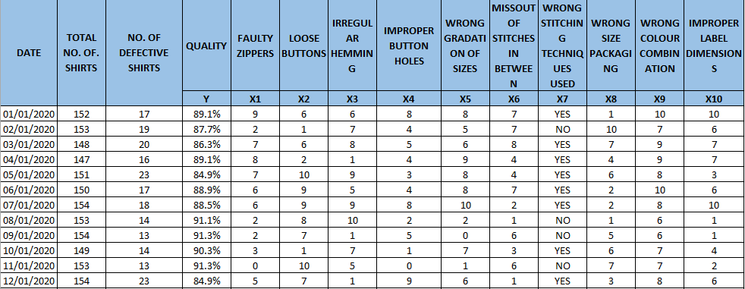
Data Collection in Excel format
Click here
Proprietary and Highly Confidential. 2020 Pursullence Global Business Solutions. All Rights Reserved
Notes:
Note:- Excel sheet dataset is embedded into slide for your reference

Slide 20
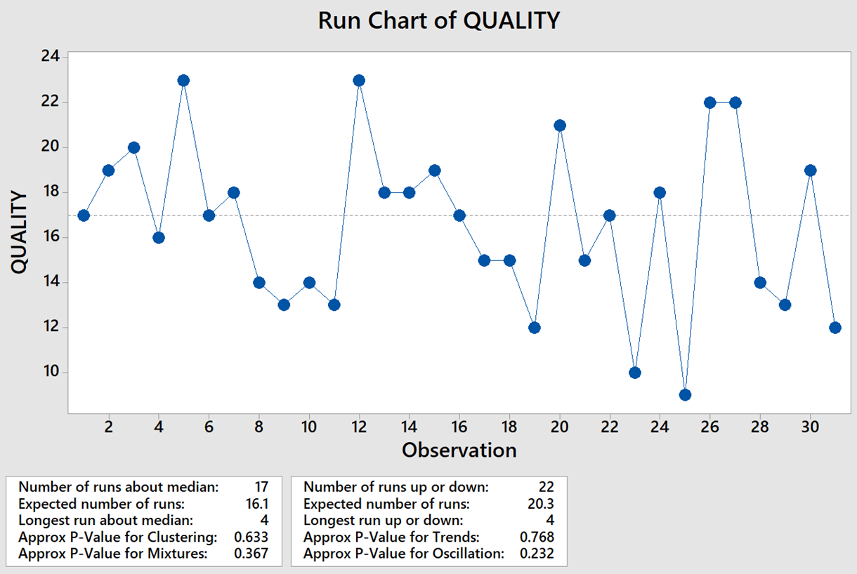
Stability Analysis- Run Chart
Interpretation:
There are no p-values less than 0.05(alpha value), therefore no statistical evidence of unusual process behavior exists, i.e. the data is stable.
Proprietary and Highly Confidential. 2020 Pursullence Global Business Solutions. All Rights Reserved
Notes:
Hint:
Step 1: Select the data and perform the Stability test using Run chart in Minitab tool by referring the steps below.
Step 2: Follow this Minitab Path to get the output : Stat->Quality Tools –> Run Chart
Step 3: Paste the output of Run chart in the given box and write interpretation by reading the chart

Slide 21
Normality Analysis- Normality Chart
Interpretation:
Since the p- value is greater than 0.05 (alpha value), we fail to reject normality and hence, the data is normal.
Proprietary and Highly Confidential. 2020 Pursullence Global Business Solutions. All Rights Reserved
Notes:
Hint:
Step 1: Select the data and perform the Normality test in Minitab tool by referring the steps below.
Step 2: Follow this Minitab Path to get the output : Stat->Basic Statistics –> Normality Test
Step 3: Paste the output of Normality Test in the given box and write interpretation by reading the p value.

Slide 22
CAPABILITY ANALYSIS
DEFECTIVE DEFINITION | Quality Score < 95%
TOTAL UNITS | 31
TOTAL OPPORTUNITIES | 31
DEFECTIVE | 22
DEFECTS/DEFECTIVES PER OPPORTUNITIES ( HINT: Using DPO formula calculate DPO value) | 0.709677
DEFECTIVES PER MILLION OPPORTUNITIES ( HINT: Using DPMO formula calculate value ) | 709677.4193
LONG TERM SIGMA VALUE (ZLT) ( HINT: Use formula :- normsinv( 1- DPO) | -0.55244
SHORT TERM SIGMA VALUE (ZST) ( HINT: N/A) | 0.947557
Proprietary and Highly Confidential. 2020 Pursullence Global Business Solutions. All Rights Reserved
Notes:
HINT:-
Refer to the DPMO formulas & find the appropriate values of parameters of capability analysis.
2) CAPABILITY ANALYSIS: Solutions for Capability analysis are displayed in hint section.
1) Defective Definition -
2) Total Units -
3) Total Opportunities -
4) Defective -
5) Defects/Defectives Per Opportunities -
6) Defectives Per Million Opportunities -
7) LONG TERM SIGMA VALUE (ZLT) = normsinv ( 1- DPO) =

Slide 23
ANALYZE PHASE

Slide 24
GRAPHICAL ANALYSIS
Proprietary and Highly Confidential. 2020 Pursullence Global Business Solutions. All Rights Reserved

Slide 25
Histogram via ‘Graphical Summary’ – For % Quality Score Per Day
Minitab Session Window output:
Interpretation:
Since the p- value is greater than 0.05 (alpha value), we fail to reject normality and hence, the data is normal.
Proprietary and Highly Confidential. 2020 Pursullence Global Business Solutions. All Rights Reserved
Notes:
Steps to draw Histogram:
Step1: Minitab Path: Stat> Basic Statistics> Graphical Summary (enter ‘Quality’ for ‘Variables’)
Step2: Draw the conclusion from the histogram about Normality of the data.
Step3: Observe the basic statistics, look at the graph, observe and write interpretation about the shape of the histogram and spread of the data.

Slide 26
BOX-PLOT
Output:- BOX PLOT FOR QUALITY (Y) VS. FAULTY ZIPPERS (X1)
Interpretation:
From the graph we can observe that, Faulty Zippers have a significant impact on Quality. We need to investigate it.
Proprietary and Highly Confidential. 2020 Pursullence Global Business Solutions. All Rights Reserved
Notes:
Steps to draw a box plot:
Step 1: For continuous Y and Discrete X we can draw box-plot.
Step 2: Follow this Minitab Path to get the output : Graph–> Box Plot
Step 3: Paste the Box Plot in the given blank box and write interpretation by reading the plot

Slide 27
BOX-PLOT
Output:- BOX PLOT FOR QUALITY (Y) VS. LOOSE BUTTONS (X2)
Interpretation:
From the graph we can observe that, Loose Buttons have a significant impact on Quality. We need to investigate it.
Proprietary and Highly Confidential. 2020 Pursullence Global Business Solutions. All Rights Reserved
Notes:
Steps to draw a box plot:
Step 1: For continuous Y and Discrete X we can draw box-plot.
Step 2: Follow this Minitab Path to get the output : Graph–> Box Plot
Step 3: Paste the Box Plot in the given blank box and write interpretation by reading the plot

Slide 28
BOX-PLOT
Output:- BOX PLOT FOR QUALITY (Y) VS. IRREGULAR HEMMING (X3)
Interpretation:
From the graph we can observe that, Irregular Hemming has a significant impact on Quality. We need to investigate it.
Proprietary and Highly Confidential. 2020 Pursullence Global Business Solutions. All Rights Reserved
Notes:
Steps to draw a box plot:
Step 1: For continuous Y and Discrete X we can draw box-plot.
Step 2: Follow this Minitab Path to get the output : Graph–> Box Plot
Step 3: Paste the Box Plot in the given blank box and write interpretation by reading the plot

Slide 29
BOX-PLOT
Output:- BOX PLOT FOR QUALITY (Y) VS. IMPROPER BUTTON HOLES (X4)
Interpretation:
From the graph we can observe that, Improper Button Holes have a significant impact on Quality. We need to investigate it.
Proprietary and Highly Confidential. 2020 Pursullence Global Business Solutions. All Rights Reserved
Notes:
Steps to draw a box plot:
Step 1: For continuous Y and Discrete X we can draw box-plot.
Step 2: Follow this Minitab Path to get the output : Graph–> Box Plot
Step 3: Paste the Box Plot in the given blank box and write interpretation by reading the plot

Slide 30
BOX-PLOT
Output:- BOX PLOT FOR QUALITY (Y) VS. WRONG GRADATION OF SIZES (X5)
Interpretation:
From the graph we can observe that, Wrong Gradation of Sizes has a significant impact on Quality. We need to investigate it.
Proprietary and Highly Confidential. 2020 Pursullence Global Business Solutions. All Rights Reserved
Notes:
Steps to draw a box plot:
Step 1: For continuous Y and Discrete X we can draw box-plot.
Step 2: Follow this Minitab Path to get the output : Graph–> Box Plot
Step 3: Paste the Box Plot in the given blank box and write interpretation by reading the plot

Slide 31
BOX-PLOT
Output:- BOX PLOT FOR QUALITY (Y) VS. MISS OUT OF STITCHES IN BETWEEN (X6)
Interpretation:
From the graph we can observe that, Miss out of Stitches in Between has a significant impact on Quality. We need to investigate it.
Proprietary and Highly Confidential. 2020 Pursullence Global Business Solutions. All Rights Reserved
Notes:
Steps to draw a box plot:
Step 1: For continuous Y and Discrete X we can draw box-plot.
Step 2: Follow this Minitab Path to get the output : Graph–> Box Plot
Step 3: Paste the Box Plot in the given blank box and write interpretation by reading the plot

Slide 32
INTERVAL-PLOT
Output:- INTERVAL PLOT FOR QUALITY (Y) VS. WRONG STITCHING TECHNIQUES USED (X7)
Interpretation:
From the graph we can observe that, Wrong Stitching Techniques Used has a significant impact on Quality. We need to investigate it.
Proprietary and Highly Confidential. 2020 Pursullence Global Business Solutions. All Rights Reserved
Notes:
Steps to draw a box plot:
Step 1: For continuous Y and Discrete X we can draw box-plot.
Step 2: Follow this Minitab Path to get the output : Graph–> Box Plot
Step 3: Paste the Box Plot in the given blank box and write interpretation by reading the plot

Slide 33
BOX-PLOT
Output:- BOX PLOT FOR QUALITY (Y) VS. WRONG SIZE PACKAGING (X8)
Interpretation:
From the graph we can observe that, Wrong Size Packaging has a significant impact on Quality. We need to investigate it.
Proprietary and Highly Confidential. 2020 Pursullence Global Business Solutions. All Rights Reserved
Notes:
Steps to draw a box plot:
Step 1: For continuous Y and Discrete X we can draw box-plot.
Step 2: Follow this Minitab Path to get the output : Graph–> Box Plot
Step 3: Paste the Box Plot in the given blank box and write interpretation by reading the plot

Slide 34
BOX-PLOT
Output:- BOX PLOT FOR QUALITY (Y) VS. WRONG COLOUR COMBINATION (X9)
Interpretation:
From the graph we can observe that, Wrong Colour Combination has a significant impact on Quality. We need to investigate it.
Proprietary and Highly Confidential. 2020 Pursullence Global Business Solutions. All Rights Reserved
Notes:
Steps to draw a box plot:
Step 1: For continuous Y and Discrete X we can draw box-plot.
Step 2: Follow this Minitab Path to get the output : Graph–> Box Plot
Step 3: Paste the Box Plot in the given blank box and write interpretation by reading the plot

Slide 35
BOX-PLOT
Output:- BOX PLOT FOR QUALITY (Y) VS. IMPROPER LABEL DIMENSIONS (X10)
Interpretation:
From the graph we can observe that, Improper Label Dimensions have a significant impact on Quality. We need to investigate it.
Proprietary and Highly Confidential. 2020 Pursullence Global Business Solutions. All Rights Reserved
Notes:
Steps to draw a box plot:
Step 1: For continuous Y and Discrete X we can draw box-plot.
Step 2: Follow this Minitab Path to get the output : Graph–> Box Plot
Step 3: Paste the Box Plot in the given blank box and write interpretation by reading the plot

Slide 36
INFERENTIAL TEST
Proprietary and Highly Confidential. 2020 Pursullence Global Business Solutions. All Rights Reserved

Slide 37
Important Note 1:
Before going to start with inferential analysis we need to check the rules:
Rule 1: Stability of Y (Which is the part of measure phase)
Rule 2: As % Quality Score Per Day i.e. Y is continuous, you need to check normality of the Y (Which is the part of measure phase)
Rule 3: As Y is Continuous and X’s are discrete, you need to perform test for equality of variances.
Proprietary and Highly Confidential. 2020 Pursullence Global Business Solutions. All Rights Reserved
Notes:
Read the slide- Important Note 1: Need to check assumptions/rules first.

Slide 38
Important Note 2:
There are tests which help us to check whether the variances of the groups are same or not and we need to choose those tests by looking at the normality of Y & levels of X’s.
F Test or Two Variance Test – When there are two groups and it is Normally Distributed
Bartlett’s Test – When there are more than two groups and it is Normally Distributed
Levene’s Test - When there are two or more than two groups and it is Not Normally Distributed
Proprietary and Highly Confidential. 2020 Pursullence Global Business Solutions. All Rights Reserved
Notes:
Read the slide- Important Note 2: Selection of test to test the equality of variance.

Slide 39
Test of Equal Variance
HYOTHETICAL PREMISE
The project team believes that there are potential “X’s” that have impact on “Y” (% Quality Score per day).
One need to validate whether impact of potential X’s - “Faulty zippers”, “Loose buttons”, “Irregular hemming”, “Improper button holes”, “Wrong gradation of sizes”, “Miss out of stitches in between”, “Wrong stitching techniques used”, “Wrong size packaging“, “Wrong colour combination”, “Improper label dimensions” is statistically significant or not.
Proprietary and Highly Confidential. 2020 Pursullence Global Business Solutions. All Rights Reserved

Slide 40
Test of Equal Variance (Bartlett’s Test) For Faulty Zippers (X1)
Purpose:
Purpose of performing test of equal variance is to check whether the observations of Faulty Zippers are statistically significant enough to make an impact on Quality Score
HYPOTHESIS:
H_{o}: The std. deviation/variance of ‘Quality Score’ across 2 or more subcategories of ‘Faulty Zippers’ are same. i.e. Faulty Zippers have no impact on Quality Score.
H_{a}: The std. deviation/variance of ‘Quality Score’ across 2 or more subcategories of ‘Faulty Zippers’ are not same. i.e. Faulty Zippers have impact on Quality Score.
Proprietary and Highly Confidential. 2020 Pursullence Global Business Solutions. All Rights Reserved
Notes:
Steps to perform Test of Equality of Variance:
Step 1: Write the purpose of doing Test of Equality of Variance
Step 2: Write Null and Alternate Hypothesis

Slide 41
Graphical Output of Test of Equal Variance for Faulty Zippers (X1)
Minitab Session Window output:
Interpretation:
The outliers are observed in 6,7 and 9 Faulty Zippers . The shape and spread of box plots for all Faulty Zippers are different.
Proprietary and Highly Confidential. 2020 Pursullence Global Business Solutions. All Rights Reserved
Notes:
Steps to perform Test of Equality of Variance continued:
Step 3: Follow this Minitab Path to get the output : Stat>ANOVA>Test for Equal Variances. Run the test and paste the graphical output in the blank space.
Step 4: Write interpretation from the graph.

Slide 42
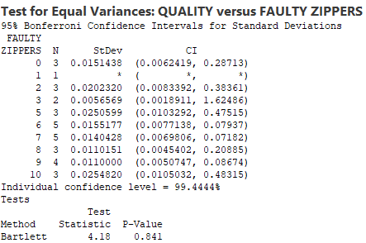
Test Output of Test of Equal Variance for Faulty Zippers (X1)
Minitab Session Window output:
Interpretation:
Since p-value is more than 0.05, we fail to reject null hypothesis. Hence, we can conclude that there is no impact of “Faulty Zippers” on Quality score.
Proprietary and Highly Confidential. 2020 Pursullence Global Business Solutions. All Rights Reserved
Notes:
Steps to perform Test of Equality of Variance continued:
Step 3: Follow this Minitab Path to get the output : Stat>ANOVA>Test for Equal Variances. Run the test and paste the graphical output in the blank space.
Step 4: Write interpretation from the graph.

Slide 43
Test of Equal Variance (Bartlett's Test) For Loose Buttons (X2)
Purpose:
Purpose of performing test of equal variance is to check whether the observations of Loose Buttons are statistically significant enough to make an impact on Quality Score
HYPOTHESIS:
H_{o}: The std. deviation/variance of ‘Quality Score’ across 2 or more subcategories of ‘Loose Buttons’ are same. i.e. Faulty Zippers have no impact on Quality Score.
H_{a}: The std. deviation/variance of ‘Quality Score’ across 2 or more subcategories of ‘Loose Buttons’ are not same. i.e. Faulty Zippers have impact on Quality Score.
Proprietary and Highly Confidential. 2020 Pursullence Global Business Solutions. All Rights Reserved
Notes:
Steps to perform Test of Equality of Variance:
Step 1: Write the purpose of doing Test of Equality of Variance
Step 2: Write Null and Alternate Hypothesis

Slide 44
Graphical Output of Test of Equal Variance for Loose Buttons (X2)
Minitab Session Window output:
Interpretation:
The outliers are observed in 1,6,7 and 8 Loose Buttons . The shape and spread of box plots for all Loose Buttons are different.
Proprietary and Highly Confidential. 2020 Pursullence Global Business Solutions. All Rights Reserved
Notes:
Steps to perform Test of Equality of Variance continued:
Step 3: Follow this Minitab Path to get the output : Stat>ANOVA>Test for Equal Variances. Run the test and paste the graphical output in the blank space.
Step 4: Write interpretation from the graph.

Slide 45
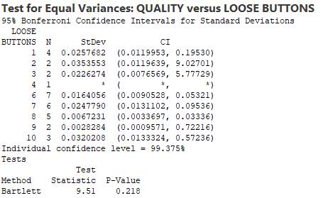
Test Output of Test of Equal Variance for Loose Buttons (X2)
Minitab Session Window output:
Interpretation:
Since p-value is more than 0.05, we fail to reject null hypothesis. Hence, we can conclude that there is no impact of “Loose Buttons” on Quality score.
Proprietary and Highly Confidential. 2020 Pursullence Global Business Solutions. All Rights Reserved
Notes:
Steps to perform Test of Equality of Variance continued:
Step 5: Paste the test output in the blank space.
Step 6: Write interpretation and conclusion from the P-value.

Slide 46
Test of Equal Variance (Bartlett’s Test) For Irregular Hemming (X3)
Purpose:
Purpose of performing test of equal variance is to check whether the observations of Irregular Hemming are statistically significant enough to make an impact on Quality Score
HYPOTHESIS:
H_{o}: The std. deviation/variance of ‘Quality Score’ across 2 or more subcategories of ‘Irregular Hemming’ are same. i.e. Irregular Hemming has no impact on Quality Score.
H_{a}: The std. deviation/variance of ‘Quality Score’ across 2 or more subcategories of ‘Irregular Hemming’ are not same. i.e. Irregular Hemming has impact on Quality Score.
Proprietary and Highly Confidential. 2020 Pursullence Global Business Solutions. All Rights Reserved
Notes:
Steps to perform Test of Equality of Variance:
Step 1: Write the purpose of doing Test of Equality of Variance
Step 2: Write Null and Alternate Hypothesis

Slide 47
Graphical Output of Test of Equal Variance for Irregular Hemming (X3)
Minitab Session Window output:
Interpretation:
The outliers are observed in 1,3,4 and 6 Irregular Hemming .The shape and spread of box plots for all Irregular Hamming are different.
Proprietary and Highly Confidential. 2020 Pursullence Global Business Solutions. All Rights Reserved
Notes:
Steps to perform Test of Equality of Variance continued:
Step 3: Follow this Minitab Path to get the output : Stat>ANOVA>Test for Equal Variances. Run the test and paste the graphical output in the blank space.
Step 4: Write interpretation from the graph.

Slide 48
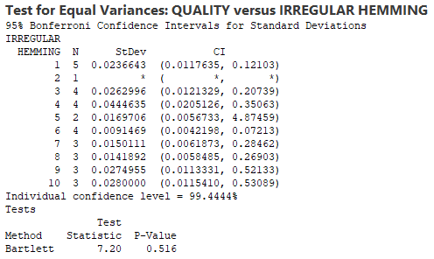
Test Output of Test of Equal Variance for Irregular Hemming (X3)
Minitab Session Window output:
Interpretation:
Since p-value is more than 0.05, we fail to reject null hypothesis. Hence, we can conclude that there is no impact of “Irregular Hemming” on Quality score.
Proprietary and Highly Confidential. 2020 Pursullence Global Business Solutions. All Rights Reserved
Notes:
Steps to perform Test of Equality of Variance continued:
Step 5: Paste the test output in the blank space.
Step 6: Write interpretation and conclusion from the P-value.

Slide 49
Test of Equal Variance ( Bartlett’s Test) For Improper Button Holes (X4)
Purpose:
Purpose of performing test of equal variance is to check whether the observations of Improper Button Holes are statistically significant enough to make an impact on Quality Score
HYPOTHESIS:
H_{o}: The std. deviation/variance of ‘Quality Score’ across 2 or more subcategories of ‘Improper Button Holes’ are same. i.e. Improper Button Holes has no impact on Quality Score.
H_{a}: The std. deviation/variance of ‘Quality Score’ across 2 or more subcategories of ‘Improper Button Holes’ are not same. i.e. Improper Button Holes has impact on Quality Score.
Proprietary and Highly Confidential. 2020 Pursullence Global Business Solutions. All Rights Reserved
Notes:
Steps to perform Test of Equality of Variance:
Step 1: Write the purpose of doing Test of Equality of Variance
Step 2: Write Null and Alternate Hypothesis

Slide 50
Graphical Output of Test of Equal Variance for Improper Button Holes (X4)
Minitab Session Window output:
Interpretation:
The outliers are observed in 2,4,5 and 8 Improper Button Holes .The shape and spread of box plots for all Improper Button Holes are different.
Proprietary and Highly Confidential. 2020 Pursullence Global Business Solutions. All Rights Reserved
Notes:
Steps to perform Test of Equality of Variance continued:
Step 3: Follow this Minitab Path to get the output : Stat>ANOVA>Test for Equal Variances. Run the test and paste the graphical output in the blank space.
Step 4: Write interpretation from the graph.

Slide 51
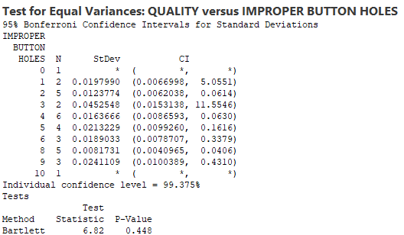
Test Output of Test of Equal Variance for Improper Button Holes (X4)
Minitab Session Window output:
Interpretation:
Since p-value is more than 0.05, we fail to reject null hypothesis. Hence, we can conclude that there is no impact of “Improper Button Holes” on Quality score.
Proprietary and Highly Confidential. 2020 Pursullence Global Business Solutions. All Rights Reserved
Notes:
Steps to perform Test of Equality of Variance continued:
Step 5: Paste the test output in the blank space.
Step 6: Write interpretation and conclusion from the P-value.

Slide 52
Test of Equal Variance (Bartlett’s Test) For Wrong Gradation of Sizes (X5)
Purpose:
Purpose of performing test of equal variance is to check whether the observations of Wrong Gradation of Sizes are statistically significant enough to make an impact on Quality Score
HYPOTHESIS:
H_{o}: The std. deviation/variance of ‘Quality Score’ across 2 or more subcategories of ‘Wrong Gradation of Sizes’ are same. i.e. Wrong Gradation of Sizes has no impact on Quality Score.
H_{a}: The std. deviation/variance of ‘Quality Score’ across 2 or more subcategories of ‘Wrong Gradation of Sizes’ are not same. i.e. Wrong Gradation of Sizes has impact on Quality Score.
Proprietary and Highly Confidential. 2020 Pursullence Global Business Solutions. All Rights Reserved
Notes:
Steps to perform Test of Equality of Variance:
Step 1: Write the purpose of doing Test of Equality of Variance
Step 2: Write Null and Alternate Hypothesis

Slide 53
Graphical Output of Test of Equal Variance for Wrong Gradation of Sizes (X5)
Minitab Session Window output:
Interpretation:
The outliers are observed in 2,5 and 8 Wrong Gradation of Sizes .The shape and spread of box plots for all Wrong Gradation of Sizes are different.
Proprietary and Highly Confidential. 2020 Pursullence Global Business Solutions. All Rights Reserved
Notes:
Steps to perform Test of Equality of Variance continued:
Step 3: Follow this Minitab Path to get the output : Stat>ANOVA>Test for Equal Variances. Run the test and paste the graphical output in the blank space.
Step 4: Write interpretation from the graph.

Slide 54
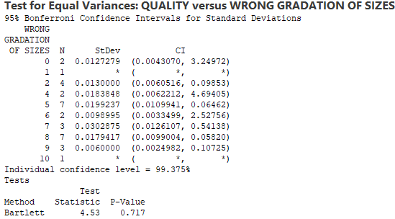
Test Output of Test of Equal Variance for Wrong Gradation of Sizes (X5)
Minitab Session Window output:
Interpretation:
Since p-value is more than 0.05, we fail to reject null hypothesis. Hence, we can conclude that there is no impact of “Wrong Gradation of Sizes” on Quality score.
Proprietary and Highly Confidential. 2020 Pursullence Global Business Solutions. All Rights Reserved
Notes:
Steps to perform Test of Equality of Variance continued:
Step 5: Paste the test output in the blank space.
Step 6: Write interpretation and conclusion from the P-value.

Slide 55
Test of Equal Variance (Bartlett’s Test) For Miss out of stitches in between (X6)
Purpose:
Purpose of performing test of equal variance is to check whether the observations of Miss out of stitches in between are statistically significant enough to make an impact on Quality Score
HYPOTHESIS:
H_{o}: The std. deviation/variance of ‘Quality Score’ across 2 or more subcategories of ‘Miss out of stitches in between’ are same. i.e. Miss out of stitches in between has no impact on Quality Score.
H_{a}: The std. deviation/variance of ‘Quality Score’ across 2 or more subcategories of ‘Miss out of stitches in between’ are not same. i.e. Miss out of stitches in between has impact on Quality Score.
Proprietary and Highly Confidential. 2020 Pursullence Global Business Solutions. All Rights Reserved
Notes:
Steps to perform Test of Equality of Variance:
Step 1: Write the purpose of doing Test of Equality of Variance
Step 2: Write Null and Alternate Hypothesis

Slide 56
Graphical Output of Test of Equal Variance for Miss out of stitches in between (X6)
Minitab Session Window output:
Interpretation:
The outliers are observed in 3,6 and 7 Miss out of stitches in between .The shape and spread of box plots for all Miss out of stitches in between are different.
Proprietary and Highly Confidential. 2020 Pursullence Global Business Solutions. All Rights Reserved
Notes:
Steps to perform Test of Equality of Variance continued:
Step 3: Follow this Minitab Path to get the output : Stat>ANOVA>Test for Equal Variances. Run the test and paste the graphical output in the blank space.
Step 4: Write interpretation from the graph.

Slide 57
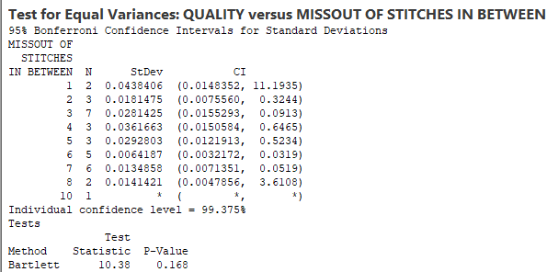
Test Output of Test of Equal Variance for Miss out of stitches in between (X6)
Minitab Session Window output:
Interpretation:
Since p-value is more than 0.05, we fail to reject null hypothesis. Hence, we can conclude that there is no impact of “Miss out of stitches in between” on Quality score.
Proprietary and Highly Confidential. 2020 Pursullence Global Business Solutions. All Rights Reserved
Notes:
Steps to perform Test of Equality of Variance continued:
Step 5: Paste the test output in the blank space.
Step 6: Write interpretation and conclusion from the P-value.

Slide 58
Test of Equal Variance (F Test) For Wrong stitching techniques used (X7)
Purpose:
Purpose of performing test of equal variance is to check whether the observations of Wrong Stitching Techniques Used are statistically significant enough to make an impact on Quality Score
HYPOTHESIS:
H_{o}: The std. deviation/variance of ‘Quality Score’ across 2 or more subcategories of ‘Wrong Stitching Techniques Used’ are same. i.e. Wrong Stitching Techniques Used has no impact on Quality Score.
H_{a}: The std. deviation/variance of ‘Quality Score’ across 2 or more subcategories of ‘Wrong Stitching Techniques Used’ are not same. i.e. Wrong Stitching Techniques Used has impact on Quality Score.
Proprietary and Highly Confidential. 2020 Pursullence Global Business Solutions. All Rights Reserved
Notes:
Steps to perform Test of Equality of Variance:
Step 1: Write the purpose of doing Test of Equality of Variance
Step 2: Write Null and Alternate Hypothesis

Slide 59
Graphical Output of Test of Equal Variance for Wrong stitching techniques used (X7)
Minitab Session Window output:
Interpretation:
The outliers are observed both in Wrong stitching techniques used and not used .The shape and spread of box plots for both Wrong stitching techniques used and not used are different.
Proprietary and Highly Confidential. 2020 Pursullence Global Business Solutions. All Rights Reserved
Notes:
Steps to perform Test of Equality of Variance continued:
Step 3: Follow this Minitab Path to get the output : Stat>ANOVA>Test for Equal Variances. Run the test and paste the graphical output in the blank space.
Step 4: Write interpretation from the graph.

Slide 60
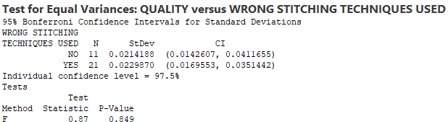
Test Output of Test of Equal Variance for Wrong stitching techniques used (X7)
Minitab Session Window output:
Interpretation:
Since p-value is more than 0.05, we fail to reject null hypothesis. Hence, we can conclude that there is no impact of “Wrong stitching techniques used” on Quality score.
Proprietary and Highly Confidential. 2020 Pursullence Global Business Solutions. All Rights Reserved
Notes:
Steps to perform Test of Equality of Variance continued:
Step 5: Paste the test output in the blank space.
Step 6: Write interpretation and conclusion from the P-value.

Slide 61
Test of Equal Variance (Bartlett’s Test) For Wrong size packaging (X8)
Purpose:
Purpose of performing test of equal variance is to check whether the observations of Wrong Size Packaging Used are statistically significant enough to make an impact on Quality Score
HYPOTHESIS:
H_{o}: The std. deviation/variance of ‘Quality Score’ across 2 or more subcategories of ‘Wrong Size Packaging’ are same. i.e. Wrong Size Packaging has no impact on Quality Score.
H_{a}: The std. deviation/variance of ‘Quality Score’ across 2 or more subcategories of ‘Wrong Size Packaging’ are not same. i.e. Wrong Size Packaging Used has impact on Quality Score.
Proprietary and Highly Confidential. 2020 Pursullence Global Business Solutions. All Rights Reserved
Notes:
Steps to perform Test of Equality of Variance:
Step 1: Write the purpose of doing Test of Equality of Variance
Step 2: Write Null and Alternate Hypothesis

Slide 62
Graphical Output of Test of Equal Variance for Wrong size packaging (X8)
Minitab Session Window output:
Interpretation:
The outliers are observed in 2 and 6.The shape and spread of box plots for all Wrong size packaging are different.
Proprietary and Highly Confidential. 2020 Pursullence Global Business Solutions. All Rights Reserved
Notes:
Steps to perform Test of Equality of Variance continued:
Step 3: Follow this Minitab Path to get the output : Stat>ANOVA>Test for Equal Variances. Run the test and paste the graphical output in the blank space.
Step 4: Write interpretation from the graph.

Slide 63
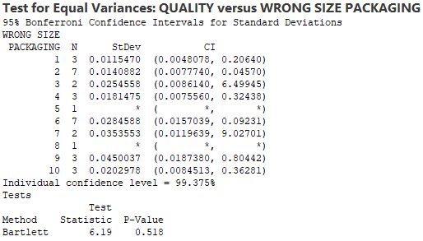
Test Output of Test of Equal Variance for Wrong size packaging (X8)
Minitab Session Window output:
Interpretation:
Since p-value is more than 0.05, we fail to reject null hypothesis. Hence, we can conclude that there is no impact of “Wrong size packaging” on Quality score.
Proprietary and Highly Confidential. 2020 Pursullence Global Business Solutions. All Rights Reserved
Notes:
Steps to perform Test of Equality of Variance continued:
Step 5: Paste the test output in the blank space.
Step 6: Write interpretation and conclusion from the P-value.

Slide 64
Test of Equal Variance (Bartlett’s Test) For Wrong colour combination (X9)
Purpose:
Purpose of performing test of equal variance is to check whether the observations of Wrong Colour Combination Used are statistically significant enough to make an impact on Quality Score
HYPOTHESIS:
H_{o}: The std. deviation/variance of ‘Quality Score’ across 2 or more subcategories of ‘Wrong Colour Combination’ are same. i.e. Wrong Colour Combination has no impact on Quality Score.
H_{a}: The std. deviation/variance of ‘Quality Score’ across 2 or more subcategories of ‘Wrong Colour Combination’ are not same. i.e. Wrong Colour Combination Used has impact on Quality Score.
Proprietary and Highly Confidential. 2020 Pursullence Global Business Solutions. All Rights Reserved
Notes:
Steps to perform Test of Equality of Variance:
Step 1: Write the purpose of doing Test of Equality of Variance
Step 2: Write Null and Alternate Hypothesis

Slide 65
Graphical Output of Test of Equal Variance for Wrong colour combination (X9)
Minitab Session Window output:
Interpretation:
The outliers are observed in 7,8,9 and 10.The shape and spread of box plots for all Wrong colour combination are different.
Proprietary and Highly Confidential. 2020 Pursullence Global Business Solutions. All Rights Reserved
Notes:
Steps to perform Test of Equality of Variance continued:
Step 3: Follow this Minitab Path to get the output : Stat>ANOVA>Test for Equal Variances. Run the test and paste the graphical output in the blank space.
Step 4: Write interpretation from the graph.

Slide 66
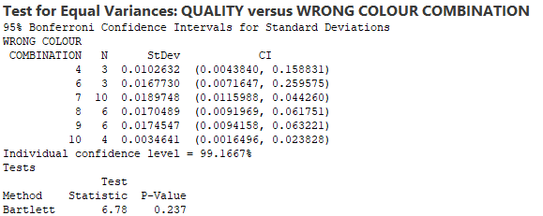
Test Output of Test of Equal Variance for Wrong colour combination (X9)
Minitab Session Window output:
Interpretation:
Since p-value is more than 0.05, we fail to reject null hypothesis. Hence, we can conclude that there is no impact of “Wrong colour combination” on Quality score.
Proprietary and Highly Confidential. 2020 Pursullence Global Business Solutions. All Rights Reserved
Notes:
Steps to perform Test of Equality of Variance continued:
Step 5: Paste the test output in the blank space.
Step 6: Write interpretation and conclusion from the P-value.

Slide 67
Test of Equal Variance (Bartlett’s Test) For Improper label dimensions (X10)
Purpose:
Purpose of performing test of equal variance is to check whether the observations of Improper Label Dimensions are statistically significant enough to make an impact on Quality Score
HYPOTHESIS:
H_{o}: The std. deviation/variance of ‘Quality Score’ across 2 or more subcategories of ‘Improper Label Dimensions’ are same. i.e. Improper Label Dimensions has no impact on Quality Score.
H_{a}: The std. deviation/variance of ‘Quality Score’ across 2 or more subcategories of ‘Improper Label Dimensions ’ are not same. i.e. Improper Label Dimensions Used has impact on Quality Score.
Proprietary and Highly Confidential. 2020 Pursullence Global Business Solutions. All Rights Reserved
Notes:
Steps to perform Test of Equality of Variance:
Step 1: Write the purpose of doing Test of Equality of Variance
Step 2: Write Null and Alternate Hypothesis

Slide 68
Graphical Output of Test of Equal Variance for Improper label dimensions (X10)
Minitab Session Window output:
Interpretation:
The outliers are observed in 3,6 and 10.The shape and spread of box plots for all Improper label dimensions are different.
Proprietary and Highly Confidential. 2020 Pursullence Global Business Solutions. All Rights Reserved
Notes:
Steps to perform Test of Equality of Variance continued:
Step 3: Follow this Minitab Path to get the output : Stat>ANOVA>Test for Equal Variances. Run the test and paste the graphical output in the blank space.
Step 4: Write interpretation from the graph.

Slide 69
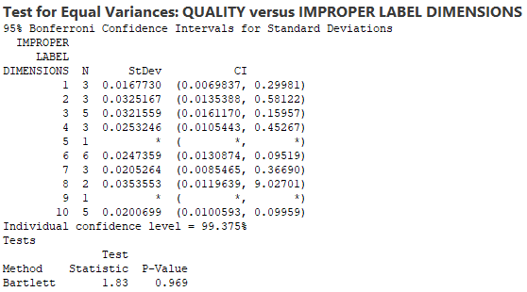
Test Output of Test of Equal Variance for Improper label dimensions (X10)
Minitab Session Window output:
Interpretation:
Since p-value is more than 0.05, we fail to reject null hypothesis. Hence, we can conclude that there is no impact of “Improper label dimensions” on Quality score.
Proprietary and Highly Confidential. 2020 Pursullence Global Business Solutions. All Rights Reserved
Notes:
Steps to perform Test of Equality of Variance continued:
Step 5: Paste the test output in the blank space.
Step 6: Write interpretation and conclusion from the P-value.

Slide 70
Result of Test of Equal Variance
Summary table of Test of equal variance for Y and all X’s (More than 2 levels)
SR. NO. | Y | X | P-VALUE | INTERPRETATION
1 | QUALITY | FAULTY ZIPPERS (X1) | 0.841 | Since p-value is more than 0.05, we fail to reject null hypothesis. Hence, we can conclude that there is no impact of “Faulty Zippers” on Quality score.
2 | QUALITY | LOOSE BUTTONS (X2) | 0.218 | Since p-value is more than 0.05, we fail to reject null hypothesis. Hence, we can conclude that there is no impact of “Loose Buttons” on Quality score.
3 | QUALITY | IRREGULAR HEMMING (X3) | 0.516 | Since p-value is more than 0.05, we fail to reject null hypothesis. Hence, we can conclude that there is no impact of “Irregular Hemming” on Quality score.
4 | QUALITY | IMPROPER BUTTON HOLES (X4) | 0.448 | Since p-value is more than 0.05, we fail to reject null hypothesis. Hence, we can conclude that there is no impact of “Improper Button Holes” on Quality score.
5 | QUALITY | WRONG GRADATION OF SIZES (X5) | 0.717 | Since p-value is more than 0.05, we fail to reject null hypothesis. Hence, we can conclude that there is no impact of “Wrong Gradation of Sizes” on Quality score.
Proprietary and Highly Confidential. 2020 Pursullence Global Business Solutions. All Rights Reserved
Notes:
Prepare a summary table of Test of equality of variances. Write P value and interpretation in the provided columns.

Slide 71
Result of Test of Equal Variance
Summary table of Test of equal variance for Y and all X’s (More than 2 levels)
SR. NO. | Y | X | P-VALUE | INTERPRETATION
6 | QUALITY | MISS OUT OF STITCHES IN BETWEEN (X6) | 0.168 | Since p-value is more than 0.05, we fail to reject null hypothesis. Hence, we can conclude that there is no impact of “Miss out of stitches in between” on Quality score.
7 | QUALITY | WRONG STITCHING TECHNIQUES USED (X7) | 0.849 | Since p-value is more than 0.05, we fail to reject null hypothesis. Hence, we can conclude that there is no impact of “Wrong stitching techniques used” on Quality score.
8 | QUALITY | WRONG SIZE PACKAGING (X8) | 0.518 | Since p-value is more than 0.05, we fail to reject null hypothesis. Hence, we can conclude that there is no impact of “Wrong colour combination” on Quality score.
9 | QUALITY | WRONG COLOUR COMBINATION (X9) | 0.237 | Since p-value is more than 0.05, we fail to reject null hypothesis. Hence, we can conclude that there is no impact of “Wrong colour combination” on Quality score.
Proprietary and Highly Confidential. 2020 Pursullence Global Business Solutions. All Rights Reserved
Notes:
Prepare a summary table of Test of equality of variances. Write P value and interpretation in the provided columns.

Slide 72
Test of Equal Variance
Summary table of Test of equal variance for Y and all X’s (With two levels)
SR. NO. | Y | X | P-VALUE | INTERPRETATION
10 | QUALITY | IMPROPER LABEL DIMENSIONS (X10) | 0.969 | Since p-value is more than 0.05, we fail to reject null hypothesis. Hence, we can conclude that there is no impact of “Improper label dimensions” on Quality score.
Proprietary and Highly Confidential. 2020 Pursullence Global Business Solutions. All Rights Reserved
Notes:
Prepare a summary table of Test of equality of variances. Write P value and interpretation in the provided columns.

Slide 73
Important Note 3:
If p value is < 0.05 then we don’t need to go for mean tests i.e. 2 sample t test or ANOVA, BUT… if p value > 0.05 then we need to further perform mean tests.
Hint:
If Y – Continuous, X – Discrete (More than 2 levels of X) Then use One Way ANOVA
If Y – Continuous, X – Discrete (2 levels of X) Then use Two sample t test
Proprietary and Highly Confidential. 2020 Pursullence Global Business Solutions. All Rights Reserved
Notes:
Read the slide- Important Note 2: Selection of test to test the means.

Slide 74
One-Way ANOVA
Y (Quality) – X1 (Faulty Zippers)
Purpose:
Purpose of performing One-Way ANOVA Test is to check whether the observations of One-Way ANOVA Test are statistically significant enough to make an impact on Quality Score
Hypothesis:
H_{o}: “Faulty Zippers” have no impact on “Quality Score”
VS
H_{a}: “Faulty Zippers” have impact on “Quality Score”
Proprietary and Highly Confidential. 2020 Pursullence Global Business Solutions. All Rights Reserved
Notes:
Steps to perform One Way ANOVA:
Step 1: Write the purpose of doing One Way ANOVA
Step 2: Write Null and Alternate Hypothesis

Slide 75
Graphical Output of One-Way ANOVA
Minitab Session Window output:
Interpretation:
The outliers are observed in 1,6,7 and 9 Loose Buttons . The shape and spread of box plots for all Loose Buttons are different.
Proprietary and Highly Confidential. 2020 Pursullence Global Business Solutions. All Rights Reserved
Notes:
Steps to perform One Way ANOVA Continued:
Step 3: Follow this Minitab Path to get the output : Stat-ANOVA-One-Way. Run the test and paste the graphical output in the blank space.
Step 4: Write interpretation from the graph.

Slide 76
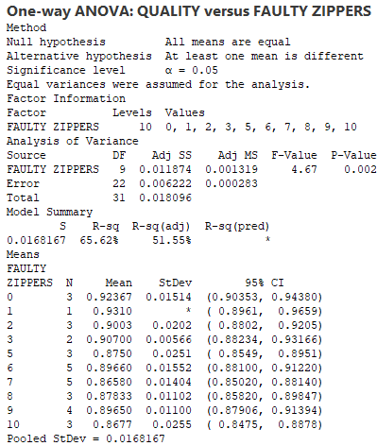
ANOVA Test Output
Minitab Session Window output:
Interpretation:
Since p-value is less than 0.05, we reject null hypothesis. Hence, we can conclude that impact of “Faulty Zippers” on Quality score is statistically significant.
Proprietary and Highly Confidential. 2020 Pursullence Global Business Solutions. All Rights Reserved
Notes:
Steps to perform One Way ANOVA Continued:
Step 5: Paste the test output in the blank space.
Step 6: Write interpretation and conclusion from the P-value.

Slide 77
One-Way ANOVA
Y (Quality) – X2 (LOOSE BUTTONS)
Purpose:
Purpose of performing One-Way ANOVA Test is to check whether the observations of One-Way ANOVA Test are statistically significant enough to make an impact on Quality Score
Hypothesis:
H_{o}: “Loose Buttons” have no impact on “Quality Score”
VS
H_{a}: “Loose Buttons” have impact on “Quality Score”
Proprietary and Highly Confidential. 2020 Pursullence Global Business Solutions. All Rights Reserved
Notes:
Steps to perform One Way ANOVA:
Step 1: Write the purpose of doing One Way ANOVA
Step 2: Write Null and Alternate Hypothesis

Slide 78
Graphical Output of One-Way ANOVA
Minitab Session Window output:
Interpretation:
The outliers are observed in 6,7 and 9 Faulty Zippers . The shape and spread of box plots for all Faulty Zippers are different.
Proprietary and Highly Confidential. 2020 Pursullence Global Business Solutions. All Rights Reserved
Notes:
Steps to perform One Way ANOVA Continued:
Step 3: Follow this Minitab Path to get the output : Stat-ANOVA-One-Way. Run the test and paste the graphical output in the blank space.
Step 4: Write interpretation from the graph.

Slide 79
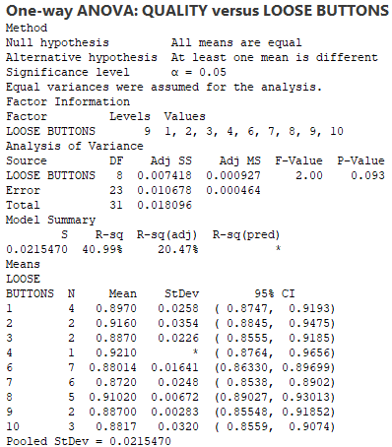
ANOVA Test Output
Minitab Session Window output:
Interpretation:
Since p-value is more than 0.05, we fail to reject null hypothesis. Hence, we can conclude that there is no impact of “Loose Buttons” on Quality score.
Proprietary and Highly Confidential. 2020 Pursullence Global Business Solutions. All Rights Reserved
Notes:
Steps to perform One Way ANOVA Continued:
Step 5: Paste the test output in the blank space.
Step 6: Write interpretation and conclusion from the P-value.

Slide 80
One-Way ANOVA
Y (Quality) – X3 (IRREGULAR HEMMING)
Purpose:
Purpose of performing One-Way ANOVA Test is to check whether the observations of One-Way ANOVA Test are statistically significant enough to make an impact on Quality Score
Hypothesis:
H_{o}: “Irregular Hemming” has no impact on “Quality Score”
VS
H_{a}: “Irregular Hemming” has impact on “Quality Score”
Proprietary and Highly Confidential. 2020 Pursullence Global Business Solutions. All Rights Reserved
Notes:
Steps to perform One Way ANOVA:
Step 1: Write the purpose of doing One Way ANOVA
Step 2: Write Null and Alternate Hypothesis

Slide 81
Graphical Output of One-Way ANOVA
Minitab Session Window output:
Interpretation:
The outliers are observed in 1,3,4 and 6 Irregular Hemming .The shape and spread of box plots for all Irregular Hamming are different.
Proprietary and Highly Confidential. 2020 Pursullence Global Business Solutions. All Rights Reserved
Notes:
Steps to perform One Way ANOVA Continued:
Step 3: Follow this Minitab Path to get the output : Stat-ANOVA-One-Way. Run the test and paste the graphical output in the blank space.
Step 4: Write interpretation from the graph.

Slide 82
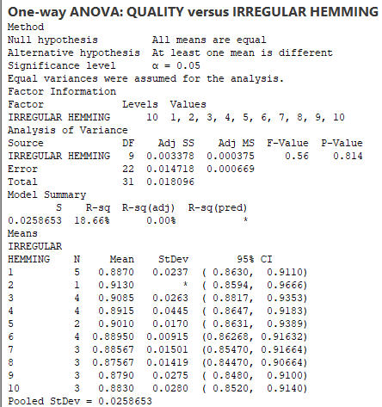
ANOVA Test Output
Minitab Session Window output:
Interpretation:
Since p-value is more than 0.05, we fail to reject null hypothesis. Hence, we can conclude that there is no impact of “Irregular Hemming” on Quality score.
Proprietary and Highly Confidential. 2020 Pursullence Global Business Solutions. All Rights Reserved
Notes:
Steps to perform One Way ANOVA Continued:
Step 5: Paste the test output in the blank space.
Step 6: Write interpretation and conclusion from the P-value.

Slide 83
One-Way ANOVA
Y (Quality) – X4 (IMPROPER BUTTON HOLES)
Purpose:
Purpose of performing One-Way ANOVA Test is to check whether the observations of One-Way ANOVA Test are statistically significant enough to make an impact on Quality Score
Hypothesis:
H_{o}: “Improper Button Holes” have no impact on “Quality Score”
VS
H_{a}: “Improper Button Holes” have impact on “Quality Score”
Proprietary and Highly Confidential. 2020 Pursullence Global Business Solutions. All Rights Reserved
Notes:
Steps to perform One Way ANOVA:
Step 1: Write the purpose of doing One Way ANOVA
Step 2: Write Null and Alternate Hypothesis

Slide 84
Graphical Output of One-Way ANOVA
Minitab Session Window output:
Interpretation:
The outliers are observed in 2,4,5 and 8 Improper Button Holes .The shape and spread of box plots for all Improper Button Holes are different.
Proprietary and Highly Confidential. 2020 Pursullence Global Business Solutions. All Rights Reserved
Notes:
Steps to perform One Way ANOVA Continued:
Step 3: Follow this Minitab Path to get the output : Stat-ANOVA-One-Way. Run the test and paste the graphical output in the blank space.
Step 4: Write interpretation from the graph.

Slide 85
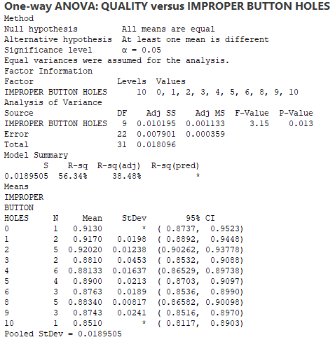
ANOVA Test Output
Minitab Session Window output:
Interpretation:
Since p-value is less than 0.05, we reject null hypothesis. Hence, we can conclude that impact of “Improper Button Holes” on Quality score is statistically significant.
Proprietary and Highly Confidential. 2020 Pursullence Global Business Solutions. All Rights Reserved
Notes:
Steps to perform One Way ANOVA Continued:
Step 5: Paste the test output in the blank space.
Step 6: Write interpretation and conclusion from the P-value.

Slide 86
One-Way ANOVA
Y (Quality) – X5 (WRONG GRADATION OF SIZES)
Purpose:
Purpose of performing One-Way ANOVA Test is to check whether the observations of One-Way ANOVA Test are statistically significant enough to make an impact on Quality Score
Hypothesis:
H_{o}: “Wrong Gradation of Sizes” has no impact on “Quality Score”
VS
H_{a}: “Wrong Gradation of Sizes” has impact on “Quality Score”
Proprietary and Highly Confidential. 2020 Pursullence Global Business Solutions. All Rights Reserved
Notes:
Steps to perform One Way ANOVA:
Step 1: Write the purpose of doing One Way ANOVA
Step 2: Write Null and Alternate Hypothesis

Slide 87
Graphical Output of One-Way ANOVA
Minitab Session Window output:
Interpretation:
The outliers are observed in 2,5 and 8 Wrong Gradation of Sizes .The shape and spread of box plots for all Wrong Gradation of Sizes are different.
Proprietary and Highly Confidential. 2020 Pursullence Global Business Solutions. All Rights Reserved
Notes:
Steps to perform One Way ANOVA Continued:
Step 3: Follow this Minitab Path to get the output : Stat-ANOVA-One-Way. Run the test and paste the graphical output in the blank space.
Step 4: Write interpretation from the graph.

Slide 88
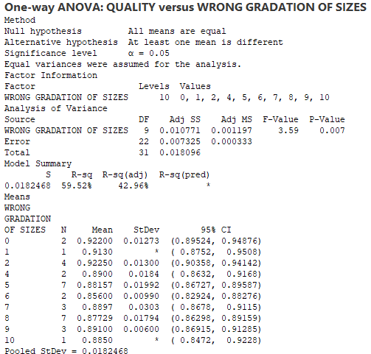
ANOVA Test Output
Minitab Session Window output:
Interpretation:
Since p-value is less than 0.05, we reject null hypothesis. Hence, we can conclude that impact of “Wrong Gradation of Sizes” on Quality score is statistically significant.
Proprietary and Highly Confidential. 2020 Pursullence Global Business Solutions. All Rights Reserved
Notes:
Steps to perform One Way ANOVA Continued:
Step 5: Paste the test output in the blank space.
Step 6: Write interpretation and conclusion from the P-value.

Slide 89
One-Way ANOVA
Y (Quality) – X6 (MISS OUT OF STITCHES IN BETWEEN)
Purpose:
Purpose of performing One-Way ANOVA Test is to check whether the observations of One-Way ANOVA Test are statistically significant enough to make an impact on Quality Score
Hypothesis:
H_{o}: “Miss Out of Stiches in Between” have no impact on “Quality Score”
VS
H_{a}: “Miss Out of Stiches in Between” have impact on “Quality Score”
Proprietary and Highly Confidential. 2020 Pursullence Global Business Solutions. All Rights Reserved
Notes:
Steps to perform One Way ANOVA:
Step 1: Write the purpose of doing One Way ANOVA
Step 2: Write Null and Alternate Hypothesis

Slide 90
Graphical Output of One-Way ANOVA
Minitab Session Window output:
Interpretation:
The outliers are observed in 3,6 and 7 Miss out of stitches in between .The shape and spread of box plots for all Miss out of stitches in between are different.
Proprietary and Highly Confidential. 2020 Pursullence Global Business Solutions. All Rights Reserved
Notes:
Steps to perform One Way ANOVA Continued:
Step 3: Follow this Minitab Path to get the output : Stat-ANOVA-One-Way. Run the test and paste the graphical output in the blank space.
Step 4: Write interpretation from the graph.

Slide 91
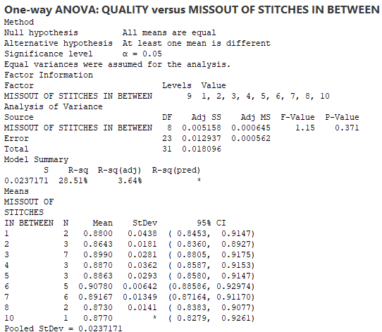
ANOVA Test Output
Minitab Session Window output:
Interpretation:
Since p-value is more than 0.05, we fail to reject null hypothesis. Hence, we can conclude that there is no impact of “Irregular Hemming” on Quality score.
Proprietary and Highly Confidential. 2020 Pursullence Global Business Solutions. All Rights Reserved
Notes:
Steps to perform One Way ANOVA Continued:
Step 5: Paste the test output in the blank space.
Step 6: Write interpretation and conclusion from the P-value.

Slide 92
Two Sample t Test
Y (Quality) – X7 (WRONG STITCHING TECHNIQUES USED)
Purpose:
Purpose of performing Two Sample t Test is to check whether the observations of Two Sample t Test are statistically significant enough to make an impact on Quality Score
Hypothesis:
H_{o}: “Wrong Stitching Techniques Used” have no impact on “Quality Score”
VS
H_{a}: “Wrong Stitching Techniques Used” have impact on “Quality Score”
Proprietary and Highly Confidential. 2020 Pursullence Global Business Solutions. All Rights Reserved
Notes:
Steps to perform Two Sample t test:
Step 1: Write the purpose of doing Two sample t test.
Step 2: Write Null and Alternate Hypothesis

Slide 93
Graphical Output of Two sample t test
Minitab Session Window output:
Interpretation:
The outliers are observed both in Wrong stitching techniques used and not used .The shape and spread of box plots for both Wrong stitching techniques used and not used are different.
Proprietary and Highly Confidential. 2020 Pursullence Global Business Solutions. All Rights Reserved
Notes:
Steps to perform Two sample t test Continued:
Step 3: Follow this Minitab Path to get the output : Stat>Basic Statistics>2 Sample t test. Run the test and paste the graphical output in the blank space.
Step 4: Write interpretation from the graph.

Slide 94
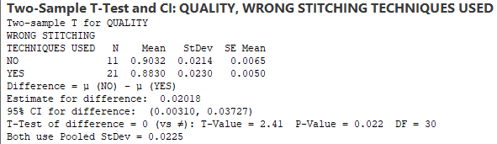
Two sample t Test Output
Minitab Session Window output:
Interpretation:
Since p-value is less than 0.05, we reject null hypothesis. Hence, we can conclude that impact of “Wrong Stitching Techniques Used” on Quality score is statistically significant.
Proprietary and Highly Confidential. 2020 Pursullence Global Business Solutions. All Rights Reserved
Notes:
Steps to perform Two sample t test Continued:
Step 5: Paste the test output in the blank space.
Step 6: Write interpretation and conclusion from the P-value.

Slide 95
One-Way ANOVA
Y (Quality) – X8 (WRONG SIZE PACKAGING)
Purpose:
Purpose of performing One-Way ANOVA Test is to check whether the observations of One-Way ANOVA Test are statistically significant enough to make an impact on Quality Score
Hypothesis:
H_{o}: “Wrong Size Packaging” has no impact on “Quality Score”
VS
H_{a}: “Wrong Size Packaging” has impact on “Quality Score”
Proprietary and Highly Confidential. 2020 Pursullence Global Business Solutions. All Rights Reserved
Notes:
Steps to perform One Way ANOVA:
Step 1: Write the purpose of doing One Way ANOVA
Step 2: Write Null and Alternate Hypothesis

Slide 96
Graphical Output of One-Way ANOVA
Minitab Session Window output:
Interpretation:
The outliers are observed in 2 and 6.The shape and spread of box plots for all Wrong size packaging are different.
Proprietary and Highly Confidential. 2020 Pursullence Global Business Solutions. All Rights Reserved
Notes:
Steps to perform One Way ANOVA Continued:
Step 3: Follow this Minitab Path to get the output : Stat-ANOVA-One-Way. Run the test and paste the graphical output in the blank space.
Step 4: Write interpretation from the graph.

Slide 97
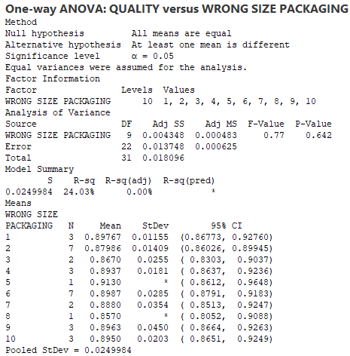
ANOVA Test Output
Minitab Session Window output:
Interpretation:
Since p-value is more than 0.05, we fail to reject null hypothesis. Hence, we can conclude that there is no impact of “Wrong Size Packaging” on Quality score.
Proprietary and Highly Confidential. 2020 Pursullence Global Business Solutions. All Rights Reserved
Notes:
Steps to perform One Way ANOVA Continued:
Step 5: Paste the test output in the blank space.
Step 6: Write interpretation and conclusion from the P-value.

Slide 98
One-Way ANOVA
Y (Quality) – X9 (WRONG COLOUR COMBINATION)
Purpose:
Purpose of performing One-Way ANOVA Test is to check whether the observations of One-Way ANOVA Test are statistically significant enough to make an impact on Quality Score
Hypothesis:
H_{o}: “Wrong Colour Combination” has no impact on “Quality Score”
VS
H_{a}: “Wrong Colour Combination” has impact on “Quality Score”
Proprietary and Highly Confidential. 2020 Pursullence Global Business Solutions. All Rights Reserved
Notes:
Steps to perform One Way ANOVA:
Step 1: Write the purpose of doing One Way ANOVA
Step 2: Write Null and Alternate Hypothesis

Slide 99
Graphical Output of One-Way ANOVA
Minitab Session Window output:
Interpretation:
The outliers are observed in 7,8,9 and 10.The shape and spread of box plots for all Wrong colour combination are different.
Proprietary and Highly Confidential. 2020 Pursullence Global Business Solutions. All Rights Reserved
Notes:
Steps to perform One Way ANOVA Continued:
Step 3: Follow this Minitab Path to get the output : Stat-ANOVA-One-Way. Run the test and paste the graphical output in the blank space.
Step 4: Write interpretation from the graph.

Slide 100
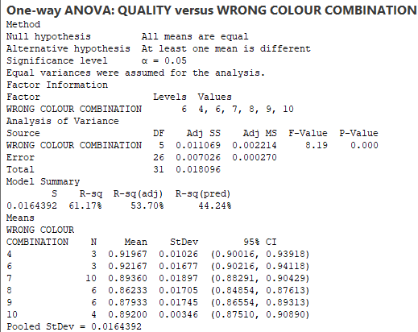
ANOVA Test Output
Minitab Session Window output:
Interpretation:
Since p-value is less than 0.05, we reject null hypothesis. Hence, we can conclude that impact of “Wrong Colour Combination” on Quality score is statistically significant.
Proprietary and Highly Confidential. 2020 Pursullence Global Business Solutions. All Rights Reserved
Notes:
Steps to perform One Way ANOVA Continued:
Step 5: Paste the test output in the blank space.
Step 6: Write interpretation and conclusion from the P-value.

Slide 101
One-Way ANOVA
Y (Quality) – X10 (IMPROPER LABEL DIMENSIONS)
Purpose:
Purpose of performing One-Way ANOVA Test is to check whether the observations of One-Way ANOVA Test are statistically significant enough to make an impact on Quality Score
Hypothesis:
H_{o}: “Improper Label Dimensions” have no impact on “Quality Score”
VS
H_{a}: “Improper Label Dimensions” have impact on “Quality Score”
Proprietary and Highly Confidential. 2020 Pursullence Global Business Solutions. All Rights Reserved
Notes:
Steps to perform One Way ANOVA:
Step 1: Write the purpose of doing One Way ANOVA
Step 2: Write Null and Alternate Hypothesis

Slide 102
Graphical Output of One-Way ANOVA
Minitab Session Window output:
Interpretation:
The outliers are observed in 3,6 and 10.The shape and spread of box plots for all Improper label dimensions are different.
Proprietary and Highly Confidential. 2020 Pursullence Global Business Solutions. All Rights Reserved
Notes:
Steps to perform One Way ANOVA Continued:
Step 3: Follow this Minitab Path to get the output : Stat-ANOVA-One-Way. Run the test and paste the graphical output in the blank space.
Step 4: Write interpretation from the graph.

Slide 103
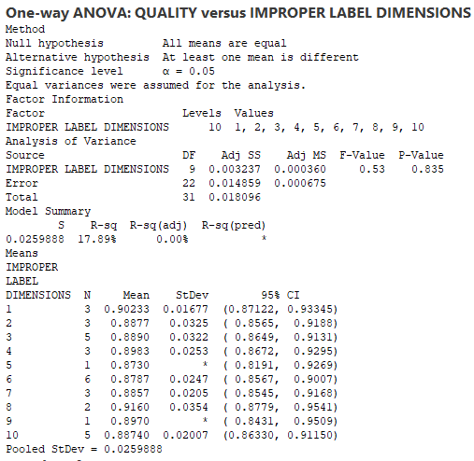
ANOVA Test Output
Minitab Session Window output:
Interpretation:
Since p-value is more than 0.05, we fail to reject null hypothesis. Hence, we can conclude that there is no impact of “Improper Label Dimensions” on Quality score.
Proprietary and Highly Confidential. 2020 Pursullence Global Business Solutions. All Rights Reserved
Notes:
Steps to perform One Way ANOVA Continued:
Step 5: Paste the test output in the blank space.
Step 6: Write interpretation and conclusion from the P-value.

Slide 104
Result of Mean Tests
Summary table of Test of equal variance for Y and all X’s
SR. NO. | Y | X | P-VALUE | INTERPRETATION
1 | % QUALITY Score Per Day | FAULTY ZIPPERS (X1) | 0.002 | Since p-value is less than 0.05, we reject null hypothesis. Hence, we can conclude that impact of “Faulty Zippers” on Quality score is statistically significant.
2 | % QUALITY Score Per Day | LOOSE BUTTONS (X2) | 0.093 | Since p-value is more than 0.05, we fail to reject null hypothesis. Hence, we can conclude that there is no impact of “Loose Buttons” on Quality score.
3 | % QUALITY Score Per Day | IRREGULAR HEMMING (X3) | 0.814 | Since p-value is more than 0.05, we fail to reject null hypothesis. Hence, we can conclude that there is no impact of “Irregular Hemming” on Quality score.
4 | % QUALITY Score Per Day | IMPROPER BUTTON HOLES (X4) | 0.013 | Since p-value is less than 0.05, we reject null hypothesis. Hence, we can conclude that impact of “Improper Button Holes” on Quality score is statistically significant.
5 | % QUALITY Score Per Day | WRONG GRADATION OF SIZES (X5) | 0.007 | Since p-value is less than 0.05, we reject null hypothesis. Hence, we can conclude that impact of “Wrong Gradation of Sizes” on Quality score is statistically significant.
Proprietary and Highly Confidential. 2020 Pursullence Global Business Solutions. All Rights Reserved
Notes:
Prepare a summary table of Mean Tests. Write P value and interpretation in the provided columns.

Slide 105
Result of Mean Tests
Summary table of Test of equal variance for Y and all X’s
SR. NO. | Y | X | P-VALUE | INTERPRETATION
6 | % QUALITY Score Per Day | MISS OUT OF STITCHES IN BETWEEN (X6) | 0.371 | Since p-value is more than 0.05, we fail to reject null hypothesis. Hence, we can conclude that there is no impact of “Irregular Hemming” on Quality score.
7 | % QUALITY Score Per Day | WRONG STITCHING TECHNIQUES USED (X7) | 0.022 | Since p-value is less than 0.05, we reject null hypothesis. Hence, we can conclude that impact of “Wrong Stitching Techniques Used” on Quality score is statistically significant.
8 | % QUALITY Score Per Day | WRONG SIZE PACKAGING (X8) | 0.642 | Since p-value is more than 0.05, we fail to reject null hypothesis. Hence, we can conclude that there is no impact of “Wrong Size Packaging” on Quality score.
9 | % QUALITY Score Per Day | WRONG COLOUR COMBINATION (X9) | 0.000 | Since p-value is less than 0.05, we reject null hypothesis. Hence, we can conclude that impact of “Wrong Colour Combination” on Quality score is statistically significant.
10 | % QUALITY Score Per Day | IMPROPER LABEL DIMENSIONS (X10) | 0.835 | Since p-value is more than 0.05, we fail to reject null hypothesis. Hence, we can conclude that there is no impact of “Improper Label Dimensions” on Quality score.
Proprietary and Highly Confidential. 2020 Pursullence Global Business Solutions. All Rights Reserved
Notes:
Prepare a summary table of Mean Tests. Write P value and interpretation in the provided columns.

Slide 106
SUMMARY TABLE
Significant Causes List from Analyze Phase
SR. NO. | Y (OUTCOME) | X (CAUSES)
1 | % QUALITY Score Per Day | FAULTY ZIPPERS (X1)
2 | % QUALITY Score Per Day | IMPROPER BUTTON HOLES (X4)
3 | % QUALITY Score Per Day | WRONG GRADATION OF SIZES (X5)
4 | % QUALITY Score Per Day | WRONG STITCHING TECHNIQUES USED (X7)
5 | % QUALITY Score Per Day | WRONG COLOUR COMBINATION (X9)
Proprietary and Highly Confidential. 2020 Pursullence Global Business Solutions. All Rights Reserved
Notes:
Prepare a table of significant causes identified in Analyze Phase.

Slide 107
IMPROVE PHASE
Proprietary and Highly Confidential. 2020 Pursullence Global Business Solutions. All Rights Reserved

Slide 108
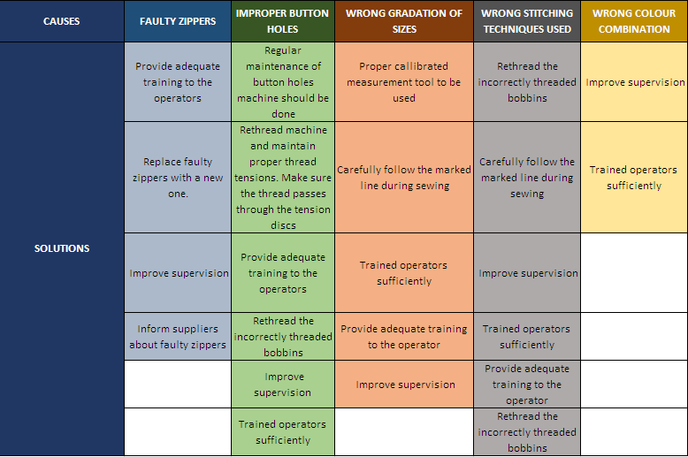
Solution Brainstorming
Click here
Proprietary and Highly Confidential. 2020 Pursullence Global Business Solutions. All Rights Reserved
Notes:
Note: Solution Brainstorming is done by Pursullence.

Slide 109
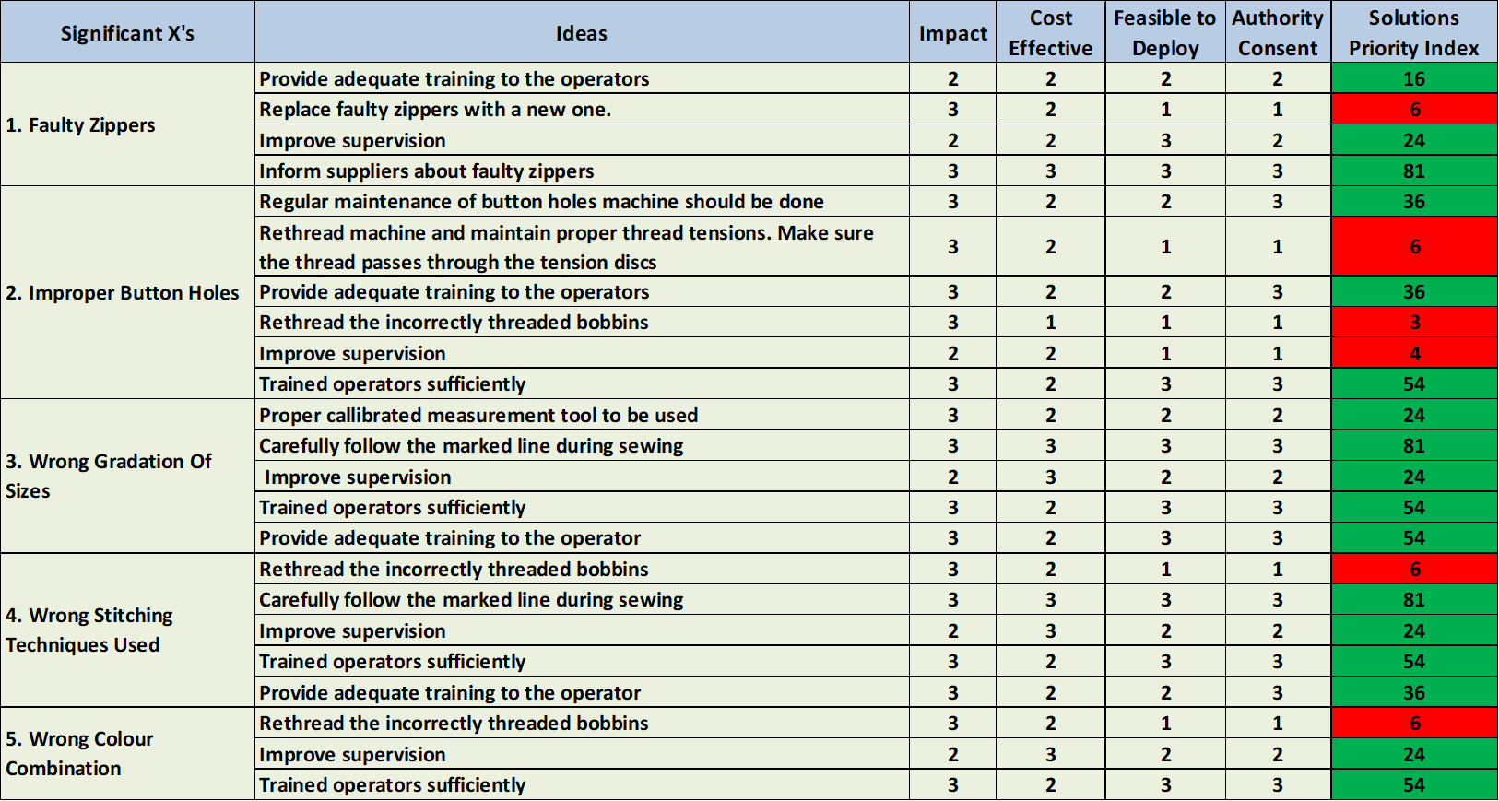
Solution Refining
Proprietary and Highly Confidential. 2020 Pursullence Global Business Solutions. All Rights Reserved
Notes:
Steps to complete Solution Refining table:
Step 1: Excel file with blank template of solution refining is embedded in this sheet. Download the excel sheet.
Step 2: Read the ideas given in the table.
Step 3: You have to give numbers from 1 to 3 (i.e. low to high) for Impact , cost effective, Feasibility to deploy and authority consent and then automatically it will compute Solutions priority index.
Step 4: In Solution priority index, green colour means, those ideas are comparatively easy to implement. (Try to get at-least one solution for each cause, which we need to use in control phase)

Slide 110
Pilot Phase Planning and Data Collection
PHASE I : SOLUTIONS SENSITIZATION ( 1st FEB 2020 to 10th FEB 2020)
From process 1 of Account 1 of Textile. Corp., bottom 10% resources are planned to analyze based on historical data. Pilot project will be implemented upon bottom 10% performers from each experience tenure level.
Project problem will be discussed with them, important causes and probable solutions need to be communicated to them in a small session. Probable challenges to implement solutions will be discussed and 10 days timeline from 1st FEB 2020 to 10th FEB 2020) will be allocated for solutions sensitization.
Process TL will track the challenges to deploy solutions and best practices sharing on daily basis.
LSSGB project leader and AM will review solution implementation status on alternate days and ensure smooth implementation of solutions and will provide adequate support.
PHASE II : ASSESSMENT OF SOLUTION STANDARDIZATION : ( 11th FEB 2020 to 12th FEB 2020 )
1. On 11th FEB 2020, a small test will be conducted among pilot participants to assess their understanding of new changes or solutions. If test will assure that > 90% participants’ scores are satisfactory, then we will confirm that solution standardization is accomplished. Update will be communicated to authorities/process owner.
PHASE III : IMPROVE PHASE DATA COLLECTION AND IMPROVEMENT VALIDATION : (20th FEB 2020 until 20th MARCH 2020 )
Improve phase data collection will commence from Monday, (20th FEB 2020 until 20th MARCH 2020) If Improvement will be achieved, it will be validated based on adequate statistical tests and capability analysis. Results will be shared with authorities and improvement will be assessed monetarily.
Proprietary and Highly Confidential. 2020 Pursullence Global Business Solutions. All Rights Reserved
Notes:
Note: Pilot Phase Planning and Data Collection is done by Pursullence.

Slide 111
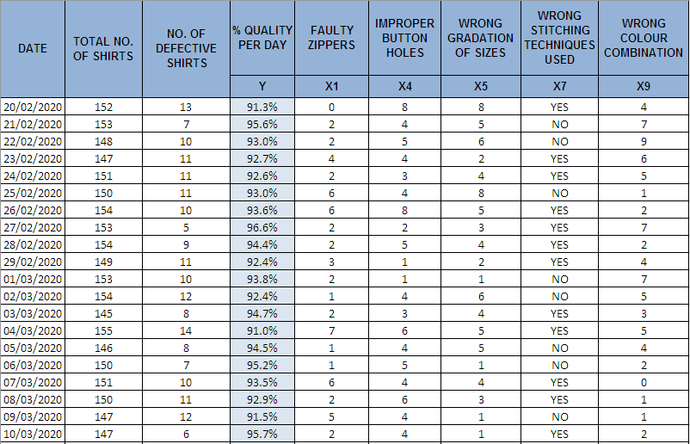
Data Collection for Improve Phase
Click here
Proprietary and Highly Confidential. 2020 Pursullence Global Business Solutions. All Rights Reserved
Notes:
Improve Phase – % Quality Score (Per Day) Data.
-Excel file is embedded on this slide.
-In this excel, data for % Quality Score(Per Day) and number of incidences are given for significant causes obtained in analyze phase.
-Use this data for further analysis of improve phase.

Slide 112
Stability Analysis
Purpose: To check whether the data is stable or unstable.
Minitab Session Window output:
Interpretation:
There are no p-values less than 0.05(alpha value), therefore no statistical evidence of unusual process behaviour exists, i.e. the data is stable.
Proprietary and Highly Confidential. 2020 Pursullence Global Business Solutions. All Rights Reserved
Notes:
Steps to draw a Run Chart:
Step 1: Draw Run chart. (Minitab Path: Stat> Control Control> Run Chart)
Step 2: Observe the p- values of parameters Clustering, Mixtures, Trends & Oscillations from the Run Chart. (You can refer previous TAT project)
Step 3: Write the interpretation about the stability of data.

Slide 113
Normality Analysis
Purpose: To check whether the data is normal or non-normal.
Minitab Session Window output:
Interpretation:
Since the p- value is greater than 0.05 (alpha value), we fail to reject normality and hence, the data is normal.
Proprietary and Highly Confidential. 2020 Pursullence Global Business Solutions. All Rights Reserved
Notes:
Steps to draw a Run Chart:
Step 1: Draw Normality Plot. (Minitab Path: Stat> Basic Statistics> Normality Test)
Step 2: Observe the p- value.(You can refer previous TAT project)
Step 3: Write the interpretation about the Normality of data.

Slide 114
Validation Test – 2 Sample t Test
Purpose:
Purpose of performing 2 Sample t test is to check if mean of Quality Score across two phases- Measure and Improve are same or not
Hypothesis:
H_{o} : After implementing the solution, Mean Quality Score across Measure and Improve phases are same.
H_{a} : After implementing the solution, Mean Quality Score in Improve Phase is more than Mean Quality Score in Measure Phase
Proprietary and Highly Confidential. 2020 Pursullence Global Business Solutions. All Rights Reserved
Notes:
Steps to perform 2 sample t test:
Step 1: Write the purpose of doing two sample t test for validation
Step 2: Write Null and Alternate Hypothesis
Step 3: Follow this Minitab Path to get the output : Stat> Basic Statistics> 2 Sample t test and paste the output in the blank space.
Step 4: Write interpretation and conclusion from the P-value.

Slide 115
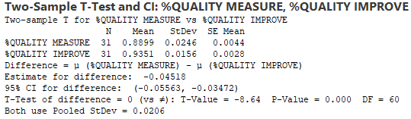
Validation Test – 2 Sample t Test
Minitab Output:
Interpretation: Since p-value is less than 0.05(alpha value), we can conclude that mean %Quality Improve is more than mean %Quality Measure.
Conclusion: Improvement is accomplished for the total population in Improve Phase.
Proprietary and Highly Confidential. 2020 Pursullence Global Business Solutions. All Rights Reserved
Notes:
Steps to perform 2 sample t test continued..
Step 3: Follow this Minitab Path to get the output : Stat> Basic Statistics> 2 Sample t test and paste the output in the blank space.
Step 4: Write interpretation and conclusion from the P-value.

Slide 116
Validation Test – 1 Sample t Test
Purpose:
Purpose of performing 1 Sample t test is to check whether the process has met the target or not
Hypothesis
H_{o} : After implementing the solution, mean performance of Quality score in Improve phase is same as Target performance, proposed in Define phase.
H_{a} : After implementing the solution, mean performance of Quality score in Improve phase is not same as Target performance, proposed in Define phase.
Proprietary and Highly Confidential. 2020 Pursullence Global Business Solutions. All Rights Reserved
Notes:
Steps to perform 1 sample t test:
Step 1: Write the purpose of doing one sample t test for validation
Step 2: Write Null and Alternate Hypothesis

Slide 117
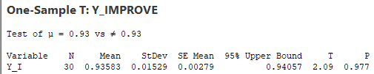
Validation Test – 1 Sample t Test
Minitab Output:
Interpretation: Since the p-value is less than 0.05 (alpha value), we reject null hypothesis, and hence, mean performance of Quality score is same as Target performance, proposed in Define phase.
Conclusion: Since the p- value is less than 0.05 (alpha value), we can conclude that the process has not met the target proposed in Define phase.
Proprietary and Highly Confidential. 2020 Pursullence Global Business Solutions. All Rights Reserved
Notes:
Steps to perform 1 sample t test continued..:
Step 3: Follow this Minitab Path to get the output : Stat> Basic Statistics> 1 Sample t test and paste the output in the blank space.
Step 4: Write interpretation and conclusion from the P-value.

Slide 118
Capability Test
Summary Table:
DEFECTIVE DEFINITION | Quality Score < 95%
TOTAL UNITS ( HINT: Take Per day Quality % data from improve phase) | 30
TOTAL OPPORTUNITIES (HINT: Here defectives & opportunities are same) | 30
DEFECTIVE ( HINT: How many defectives from CSAT data in improve phase are not meeting target 93% Quality score.) | 1
DEFECTS/DEFECTIVES PER OPPORTUNITIES (HINT: Using DPO formula calculate DPO value) | 0.0333
DEFECTIVES PER MILLION OPPORTUNITIES ( HINT: Using DPMO formula calculate value ) | 33333.3333
LONG TERM SIGMA VALUE (ZLT) (HINT: Use formula :- normsinv( 1- DPO) | 1.83
SHORT TERM SIGMA VALUE (ZST) (HINT: N/A) | 3.33
Interpretation:
Proprietary and Highly Confidential. 2020 Pursullence Global Business Solutions. All Rights Reserved
Notes:
HINT:-
Refer to the formulas provided in measure phase & find the appropriate values of parameters of capability analysis.

Slide 119
Phase-wise Sigma Value Comparison
Summarized Graph:
PHASE | SHORT TERM SIGMA VALUE | AVG
MEASURE | 0.947 | 2.1385
IMPROVE | 3.33 | 2.1385
Interpretation: From the above graph the Short Term Sigma Value was 0.947 in Measure Phase, it improved to 3.33 in Improve Phase, hence improvement is observed in Short Term Sigma Value from Measure Phase to Improve Phase.
Proprietary and Highly Confidential. 2019 Pursullence Global Business Solutions. All Rights Reserved
Notes:
Here, you have to compute sigma values for Measure and Improve phase and draw a simple bar chart with average line to compare phase-wise sigma value. Write the interpretation from the graph.
Note: For interpretation refer previous project of TAT.

Slide 120
Updated Process Map
Click here
Solutions
Proprietary and Highly Confidential. 2020 Pursullence Global Business Solutions. All Rights Reserved
Notes:
After implementing the solutions, we need to update the process map.

Slide 121
CONTROL PHASE
Proprietary and Highly Confidential. 2020 Pursullence Global Business Solutions. All Rights Reserved
Notes:
Note: Now, control phase begins from this slide.

Slide 122
FMEA
Proprietary and Highly Confidential. 2020 Pursullence Global Business Solutions. All Rights Reserved
Notes:
First we will do FMEA in Control phase.
Note: Failure Mode Effect Analysis is done by Pursullence. For your reference excel file is embedded into this slide. To open the file, double click on the excel icon given on the upper right corner.
Fill in the blanks and complete the FMEA in excel file and change the image.

Slide 123
FMEA - Continued
Proprietary and Highly Confidential. 2020 Pursullence Global Business Solutions. All Rights Reserved
Notes:
FMEA - Continued

Slide 124
Data Collection for Control Phase
DATE | TOTAL NO OF SHIRTS | NO OF DEFECTIVE SHIRTS | QUALITY (Y)
05/04/2020 | 149 | 8 | 94.7%
06/04/2020 | 152 | 12 | 92.0%
07/04/2020 | 135 | 11 | 91.6%
08/04/2020 | 154 | 13 | 91.4%
09/04/2020 | 132 | 11 | 92.0%
10/04/2020 | 157 | 4 | 97.5%
11/04/2020 | 155 | 12 | 92.1%
12/04/2020 | 151 | 10 | 93.4%
13/04/2020 | 148 | 13 | 91.1%
14/04/2020 | 132 | 11 | 92.0%
15/04/2020 | 130 | 8 | 93.7%
16/04/2020 | 141 | 12 | 91.6%
17/04/2020 | 133 | 9 | 93.4%
18/04/2020 | 147 | 11 | 92.6%
19/04/2020 | 158 | 11 | 93.2%
20/04/2020 | 134 | 13 | 90.5%
Proprietary and Highly Confidential. 2020 Pursullence Global Business Solutions. All Rights Reserved
Notes:
Control Phase – % Quality Data. Excel file is embedded on this slide.
In this excel, data for Quality score per day is given.

Slide 125
Control Chart – Continuous data- I-MR chart
Proprietary and Highly Confidential. 2020 Pursullence Global Business Solutions. All Rights Reserved
Notes:
Fill in the blanks.(“______”)
(Since, Y i.e. % Quality is continuous we need to select one of the control chart from continuous control charts. Where we will mainly look at the sample, that is how many sample taken per day. In our case we have taken 1 sample on each day, So we will select I-MR chart to check whether the process is in control or not. )
Select correct option for
1. _____________ data
a. Discrete b. Continuous
2. __________ chart
I-MR Chart b. Xbar-R Chart

Slide 126
Control Chart - I-MR Chart
Minitab Session Window output:
Interpretation:
CONTROL limits (not specification limits!) are set at 3 standard deviations from the mean. Any data points beyond these limits are unusual and should be investigated.
In the given control chart every single data point lies between upper and lower control limit expect one data point. Hence we can conclude that significant cause is stable and in control. Identified outlier was investigated, causes were found, solutions were discussed and implemented.
Proprietary and Highly Confidential. 2020 Pursullence Global Business Solutions. All Rights Reserved
Notes:
Fill in the blanks.(“______”)
To draw a I-MR- Chart:
Step 1: Follow the given Minitab path: Stat> Control Charts> Variable Charts for Individual > I-MR.
Step 2: Copy the graphical output and paste on this slide in the given box.
Step 3: Write the interpretation from the chart.

Slide 127
STABILITY ANALYSIS : Run Chart
Purpose: To check whether the data is stable or unstable.
Interpretation:
There are no p-values less than 0.05(alpha value), therefore no statistical evidence of unusual process behaviour exists, i.e. the data is stable.
Proprietary and Highly Confidential. 2020 Pursullence Global Business Solutions. All Rights Reserved
Notes:
To draw a Run Chart:
Step 1: Follow the given Minitab path: Stat> Quality Tools> Run Chart.
Step 2: Copy the graphical output and paste on this slide in the given box.
Step 3: Write the interpretation from the chart.

Slide 128
NORMALITY ANALYSIS :Normality Plot
Purpose: To check whether the data is normal or non-normal.
Interpretation:
Since the p- value is greater than 0.05 (alpha value), we fail to reject normality and hence, the data is normal.
Proprietary and Highly Confidential. 2020 Pursullence Global Business Solutions. All Rights Reserved
Notes:
To draw a Normality Chart:
Step 1: Follow the given Minitab path: Stat> Basic Statistics> Normality test
Step 2: Copy the graphical output and paste on this slide in the given box.
Step 3: Write the interpretation from the chart.

Slide 129
Validation Test – 2 Sample t Test
Purpose:
Purpose of performing 2 Sample t test is to check if mean of Quality Score across two phases- Measure and Control are same or not.
Hypothesis:
H_{o} : After implementing the solution, Mean Quality Score across Measure and Control phases are same.
H_{a} : After implementing the solution, Mean Quality Score in Control Phase is more than Mean Quality Score in Measure Phase
Proprietary and Highly Confidential. 2020 Pursullence Global Business Solutions. All Rights Reserved
Notes:
Fill in the blanks.(“______”)
Steps to perform 2 __________test:
Step 1: Write the purpose of doing 2 __________ test for validation (For this, you can refer previous project)
Step 2: Write Null and Alternate Hypothesis.
Data type of Y (% Quality) is Continuous, so we select ______________ test for validation of improvement.
Option for test:
2 Proportion test
2 Sample t test

Slide 130
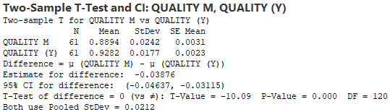
Validation Test – 2 Sample t Test
Minitab Output:
Interpretation: Since p-value is less than 0.05(alpha value), we can conclude that mean %Quality Improve is more than mean %Quality Measure.
Conclusion: Since the P-Value < 0.05, we can conclude improvement in % Quality Score is sustained in Control Phase.
Proprietary and Highly Confidential. 2020 Pursullence Global Business Solutions. All Rights Reserved
Notes:
Fill in the blanks.(“______”)
Steps to perform 2 ____________ test continued:
Step 3: Follow this Minitab Path to get the output : Stat> Basic Statistics> 2-_____________ test and paste the output in the blank space.
Step 4: Write interpretation and conclusion from the P-value.

Slide 131
Validation Test – 1 Sample t Test
Purpose:
Purpose of performing 1 Sample t test is to check whether the process has met the target or not
Hypothesis:
H_{o} : After implementing the solution, mean performance of Quality score in Control phase is same as Target performance, proposed in Define phase.
H_{a} : After implementing the solution, mean performance of Quality score in Control phase is same as Target performance, proposed in Define phase.
Proprietary and Highly Confidential. 2020 Pursullence Global Business Solutions. All Rights Reserved
Notes:
Fill in the blanks.(“______”)
Steps to perform 1 __________ test:
Step 1: Write the purpose of doing _____________ test for validation (For this, you can refer Previous projects)
Step 2: Write Null and Alternate Hypothesis.
Here Y (% Quality score) is continuous, so we select ____________ test for validation of goal achievement.
Option for test:
1 Proportion test
1 Sample t test

Slide 132
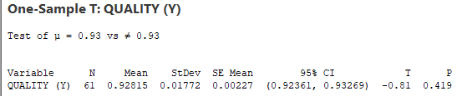
Validation Test – 1 Sample t Test
Minitab Output:
Interpretation: Since P-Value > 0.05, we fail to reject the null hypothesis. In conclusion % Quality Score in Improved Phase is same as the Targeted % Quality Score.
Conclusion: Since P-Value is greater 0.05, we can conclude that we have sustained with the target of 93% in Control Phase.
Proprietary and Highly Confidential. 2020 Pursullence Global Business Solutions. All Rights Reserved
Notes:
Fill in the blanks.(“______”)
Steps to perform 1 _____________ test continued:
Step 3: Follow this Minitab Path to get the output : Stat> Basic Statistics> 1 ____________ test and paste the output in the blank space.
Step 4: Write interpretation and conclusion from the P-value.

Slide 133
Capability Analysis
Summary Table
DEFECTIVE DEFINITION | Quality Score < 95%
TOTAL UNITS ( HINT: Take count of Quality data from control phase) | 61
TOTAL OPPORTUNITIES (HINT: Here total units & opportunities are same) | 61
DEFECTIVE ( HINT: How many defectives from Quality data in control phase are not meeting target <Target Quality score.) | 8
DEFECTS/DEFECTIVES PER OPPORTUNITIES (HINT: Using DPO formula calculate DPO value) | 0.1311475
DEFECTIVES PER MILLION OPPORTUNITIES ( HINT: Using DPMO formula calculate value ) | 131147.5
LONG TERM SIGMA VALUE (ZLT) (HINT: Use formula :- normsinv( 1- DPO) | 1.121
SHORT TERM SIGMA VALUE (ZST) (HINT: ZLT = ZST + 1.5 ) | 2.621
Proprietary and Highly Confidential. 2020 Pursullence Global Business Solutions. All Rights Reserved
Notes:
Hint:-
Refer to the formulas provided in measure phase & find the appropriate values of parameters of capability analysis.
2) Capability Analysis: Solutions for Capability analysis are displayed in hint section.
Defective Definition -
Total Units -
Total Opportunities -
Defective -
Defects/Total Opportunities -
Defectives Per Million Opportunities –
LONG TERM SIGMA VALUE (ZLT) = normsinv ( 1- DPO)

Slide 134
Phase-wise Sigma Value Comparison
Summarized Graph
PHASE | SIGMA VALUE | AVG
MEASURE | 0.947 | 2.3
IMPROVE | 3.33 | 2.3
CONTROL | 2.621 | 2.3
Interpretation: From the graph, the Short Term Sigma Value was 0.947 in Measure Phase, it is improved to 3.33 in Improve Phase and get stable in Control Phase at 2.621. Thus improvement is observed in Short Term Sigma Value from Measure Phase to Control Phase.
Proprietary and Highly Confidential. 2020 Pursullence Global Business Solutions. All Rights Reserved
Notes:
Here, you have to compute sigma value for each phase (i.e. for Measure, Improve & Control) and draw a simple bar chart with average line to compare phase-wise sigma value.
Steps to draw a bar chart for Phase-wise comparison of Sigma Value
First step is copy or write the sigma value for measure and improve phase in the table given on this slide and these values you have obtained previously.
Second is write sigma value for control which is been obtained in the control phase itself.
And once we have sigma values for three phases, then compute average sigma value of these three and write it in the third column in all the three cells.
In excel draw a simple bar graph with average line.
Last step is, write interpretation from the graph.
Note: For interpretation refer previous projects.

Slide 135
Individual Chart for Combined (Measure, Improve, Control) Performance of Y
Minitab Path: Stat> Control Charts> Variable Charts for Individuals > I-MR
Proprietary and Highly Confidential. 2020 Pursullence Global Business Solutions. All Rights Reserved
Notes:
Fill in the blanks ( “_____”)
Now, we want to compare the performance of Y (Quality Score) throughout the phases using control chart. And as Y is continuous and sample size is 1 so we will use ___ chart here also.
On this slide Minitab path is provided to draw combined ____ chart for Measure, Improve and Control Phase. Combined chart is .

Slide 136
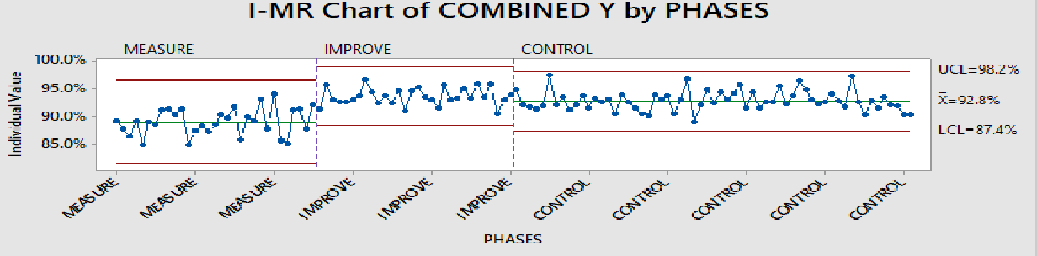
Combined Individual Chart for Performance of Y
Minitab Session Window output:
Interpretation: In Measure Phase the process is out of statistical control and % Quality Score was low. In Improve Phase the process is within control limits and % Quality Score Met count also increased.
Proprietary and Highly Confidential. 2020 Pursullence Global Business Solutions. All Rights Reserved
Notes:
To draw a combined I-MR- Chart:
(For this chart combined Measure, Improve and Control phase data like Previous project.)
Step 1: Follow the given Minitab path: Stat> Control Charts> Variable Charts for Individual > I-MR.
Step 2: Copy the graphical output and paste on this slide in the given box.
Step 3: Write the interpretation from the chart.

Slide 137
Monitoring Plan
Proprietary and Highly Confidential. 2020 Pursullence Global Business Solutions. All Rights Reserved
Notes:
Complete the Monitoring plan in the Excel sheet embedded into this slide.
Steps to create Monitoring plan:
Step 1. Write the appropriate thing in respective columns (Refer previous projects to complete this task.)

Slide 138
Response Plan
Proprietary and Highly Confidential. 2020 Pursullence Global Business Solutions. All Rights Reserved
Notes:
Complete the Response plan in the Excel sheet embedded into this slide.
Steps to create response plan:
Step 1. Write solution(s) in front of causes for which we have obtained solutions in Improve phase in solution refining.
Step 2. Write timeline to deploy solutions (Refer previous project)
Step 3. Write Responsible person that ensures solutions are implemented or not. (Refer previous project)
Step 4. Write Approval Authority(Refer previous project)

Slide 139
Project Sign off & Closure
Receiving approval from Process Owner, MBB and Finance Manager for project completion.
We computed Long term sigma, as short term sigma not applicable here. Every single month for next 3 months it will be responsibility of supervisor to share that data with GB.
The responsibility of GB is to calculate sigma value for every month. GB need to investigate If that value is less than long term sigma and if it is less and If it happens consistently for 3 months then BB need to get involve and fix it.
Submission of LSS GB project master file, cause and solutions log and relevant documents to responsible person from operation.
Proprietary and Highly Confidential. 2020 Pursullence Global Business Solutions. All Rights Reserved
Notes:
Project Sign off & Closure is given by Pursullence.
This is the last procedure of project closure.

Slide 140
HERE, WE ARE DONE WITH ALL THE FIVE PHASES OF DMAIC AND OUR QUALITY IMPROVEMENT PROJECT.
‘CONGRATULATIONS’ TO YOU ALL FOR COMPLETING THIS PROJECT.
THANK YOU!!!
Proprietary and Highly Confidential. 2020 Pursullence Global Business Solutions. All Rights Reserved
Notes:
Project completed.

